Slide 1








MONEY STAXS
More than just a team​

Slide 2
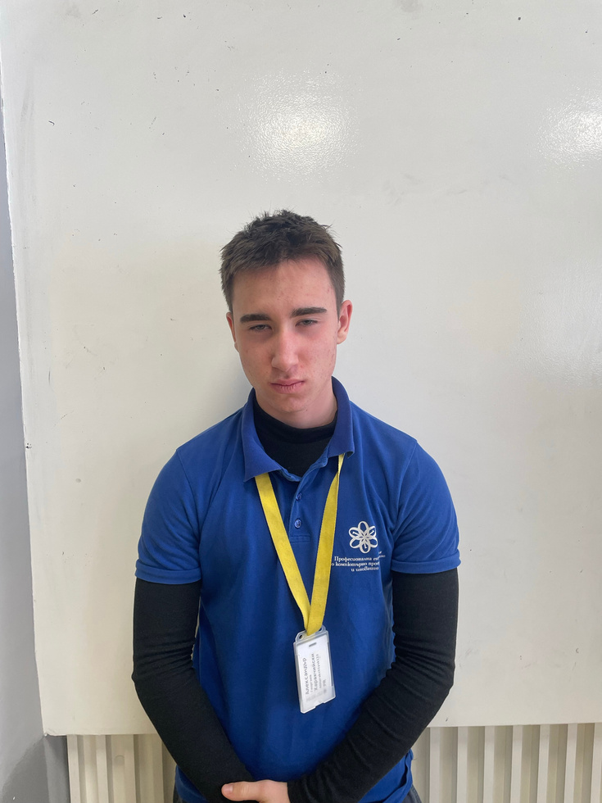
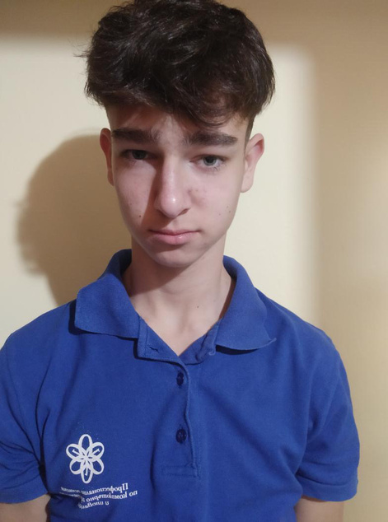
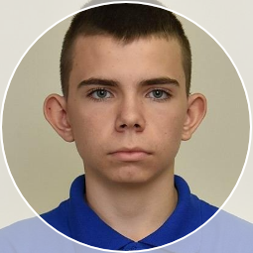
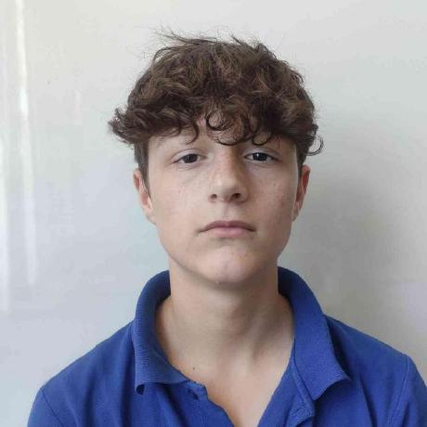
Our team
Aleksander Harakchiyski​
Miroslav Markov​
Konstantin Nachev
Dimitur Kostadinov

Slide 3





Our idea

Slide 4




STAGES OF DEVELOPMENT ​

Slide 5







THE PROGRAMS WE USED

Slide 6






Let's go to our project!​

