Slide 1
Vermogenskrieger

Slide 2
Table of contents
01
02
03
04
Team members
Topic
Stages of realization
Used technologies

Slide 3
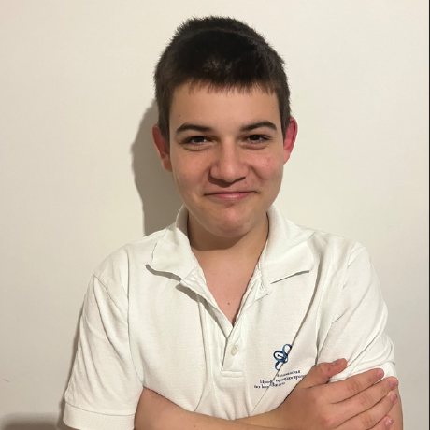
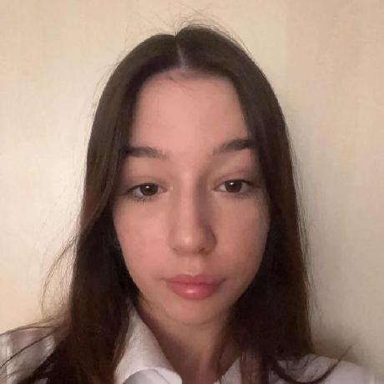

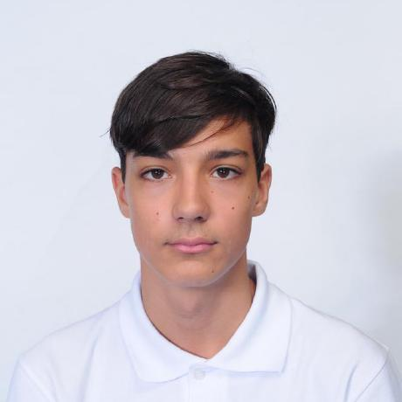
Team Members
Rumen Purvanov
Front-end developer​
10V
Kalina Atanasova
Front-end developer​
10V
Anton Kabakov
Front-end developer​
10V
Kristiyana Hristova
Scrum Trainer
10V

Slide 4
Topic
This project uses C++ to simplify essential financial calculations, showing how code can streamline finance tasks. It demonstrates C++'s effectiveness in handling financial data efficiently.

Slide 5
Stages of realization
01
02
03
04
Thinking of an idea
Organizing and giving everyone a role
Writing the code
Presenting the final result

Slide 6







Used technologies

Slide 7
Let’s jump into the project!

