Slide 1


Team
Walletech
Project on the topic
,,finance challenge''

Slide 2




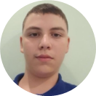
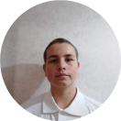
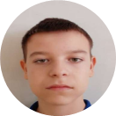
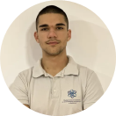
Our team
Ivelin voynov
Aleksandar lalev
Lychezar Rashkov
Daniel kostadinov
DEVELOPER
DEVELOPER
SCRUM TRAINER
DEVELOPER

Slide 3

Stages of development
01
03
Brainstorm the idea
development
Think about ideas and talk obout them.
Create the application.
02
04
Make the design
Presenting
Creating the design.
Presenting in front of judges.

Slide 4










The technologies we used

Slide 5
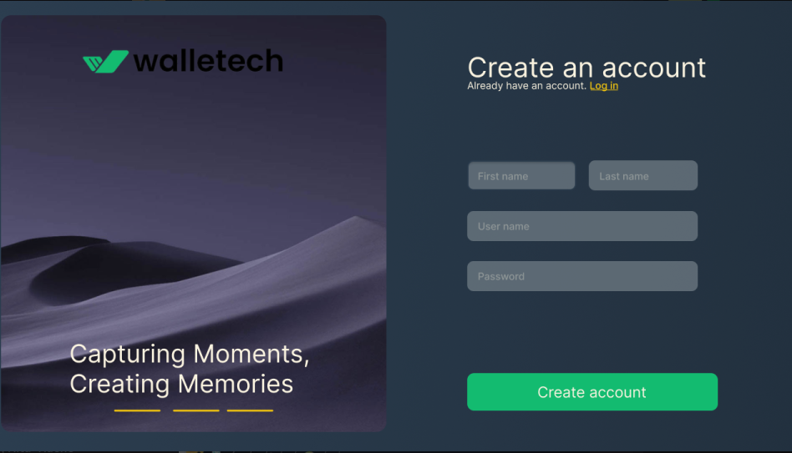
LET’S JUMP TO THE PROJECT!

