Slide 1


Girl Power
Team

Slide 2


Content
about us
idea
technologies
implementation
demo

Slide 3
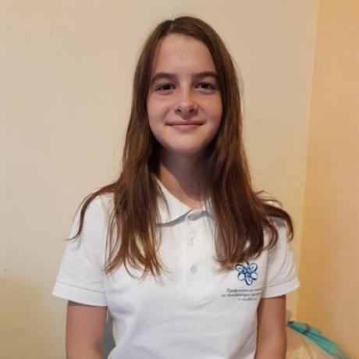
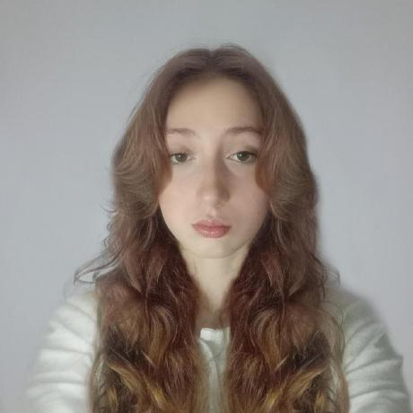
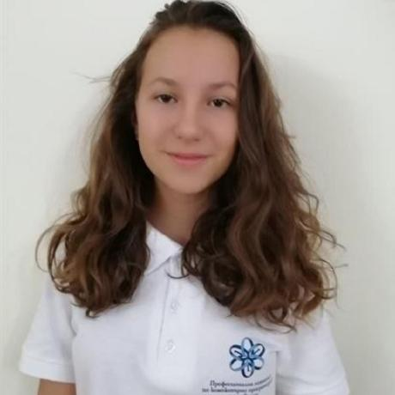

About us
Stela Georgieva
Maria Koleva
Scrum trainer
Backend Developer
Alexandra Zheleva
Jasmina Valkova
Frontend Developer
QA Engineer

Slide 4
Idea
The goal of our project was to utilize bitwise operations, whilst making a final product that is educational.
This time though, we took a twist.
We decided to instead make an applicable software for ciphering passwords and sensitive user data.

Slide 5










Tech Stack

Slide 6
Implementation
We built our application from the ground up in the span of three weeks, meaning that our project will hopefully be deemed successful.
This time around though, our time for set up and organization could have gone better. That however didn’t discourage us from working stably throughout the rest of our given time.

Slide 7
Now let’s go check out a quick
Demo!

