Slide 1

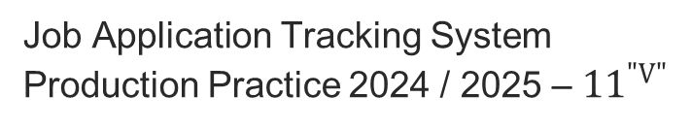
Grindin’
Job Application Tracking System
Production Practice 2024 / 2025 – ${11}^{"V"}$

Slide 2
Table of contents
1
3
Used technologies
About me
2
4
Stages of realization
The project

Slide 3

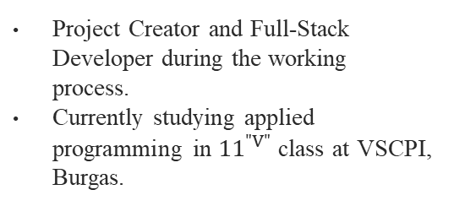
About Me
Bozhidar A. Dimov
BADimov21@codingburgas.bg
Project Creator and Full-Stack Developer during the working process.
Currently studying applied programming in ${11}^{"V"}$ class at VSCPI, Burgas.

Slide 4
Sprints
Sprint 1
Sprint 2
Sprint 3
Sprint 4
Backend Foundations
Angular Setup & Authentication
User-Side Functionality
Admin Features & Preparation
Designed the database models, implemented 3-layer architecture, and built a fully functional API with filtering, DTOs, and services for users, job ads, and applications.
Developed user features for browsing and filtering job ads, submitting applications, viewing personal data, and ensured proper frontend validation and navigation.
Set up the Angular project, built the component structure, designed login and registration forms, and implemented authentication with role-based route guards.
Implemented admin tools for managing job ads and reviewing applications, added GUI enhancements, and ensured full role-based access control throughout the app and that it functions properly. Enhanced the repository and created the presentation and the documentation.

Slide 5
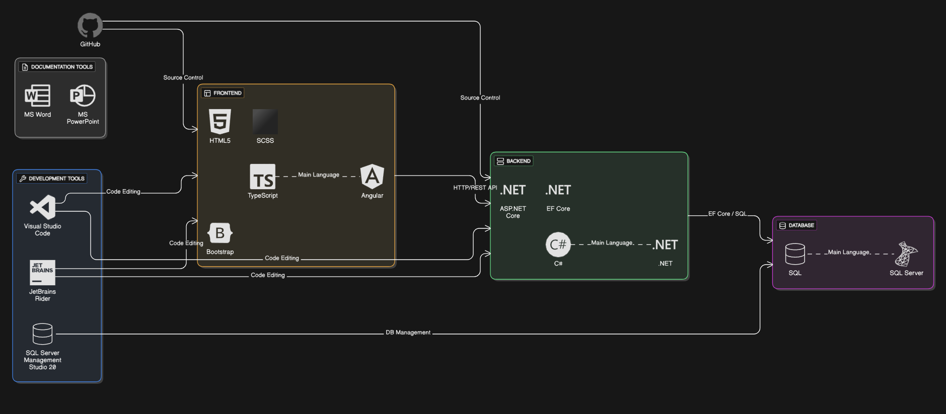
Used Technologies

Slide 6
Let’s jump to the app!

