Slide 1
ChronoFlow

Slide 2

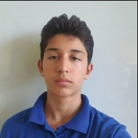
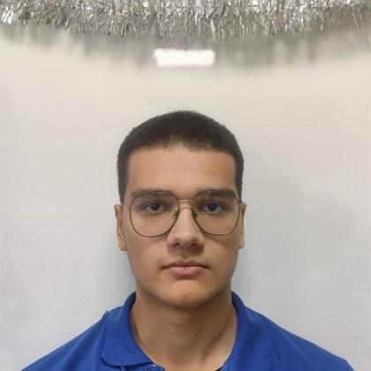
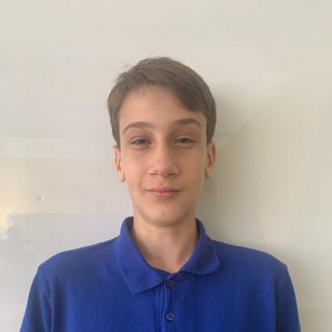
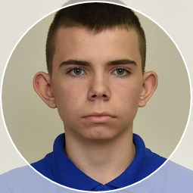
Our Team
Daniel Plamenov Hristov
Dimitur Petrov Dimitrakov
Scrum Trainer
Backend Developer
Aleksandur Stoyanov Ivanov
Konstantin Krasimirov Nachev
Frontend Developer
QA

Slide 3
About Our Project
ChronoFlow is a C++ application developed to record and manage historical events using linked lists. Events are organized primarily by date (month and/or year), with each entry containing rich details such as topic, title, location, key figures, participants, and outcomes.

Slide 4






Used Technologies

Slide 5
Let’s continue to the project

