Slide 1

East Coast Coding Crew

Slide 2
Table of contents
01
02
03
Our team
Our task
technologies

Slide 3

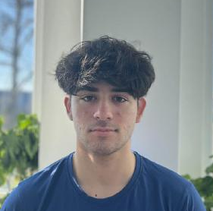
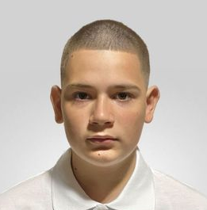
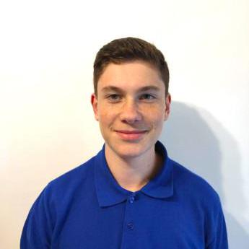
Boris Milev 10A
OUR TEAM
Aleksandar Kolev 10G
QA/Front-end
Back-end
Plamen Petkov 10A
Oleksandr Vinichenko 10G
Designer/Scrum-Trainer
Front-end

Slide 4
OUR TASK
We, the East Coast Coding Crew, are developing a console application called 'Historical Event Manager.' This application is designed to record, manage, and analyze historical events using linked lists. Users will be able to efficiently add, edit, search, delete, and generate reports on stored events based on various criteria, such as dates. Our goal is to provide an intuitive interface that simplifies the management of historical events and facilitates analysis based on user input.

Slide 5











TECHNOLOGIES

Slide 6
Let’s review!

