Slide 1

Gap
Historical Console Application

Slide 2
Table of contents
01
The team
02
The task
Technologies used
04
03
Implementation
Documenting
Strategies

Slide 3
The team
QA
Back-end Developer
Perla Hristova 10A
Scrum Trainer
Aleksandar Georgiev 10G
Nikol Stoyanova 10G

Slide 4
The task
Gap is designed to transform the exploration of historical events into an engaging and informative experience. Its user-friendly interface simplifies complex historical data, presenting events in an organized format that's easy for anyone to understand.
With search features, chronological timelines, and theme-based libraries, Gap ensures users enjoy an effective way to delve into history.

Slide 5





Technologies used
Language used
Project storage
Communication
Library used
Code control
Dev space

Slide 6
Implementation
Gap is built using C++ and Visual Studio 2022, it provides performance and secure data handling through JSON files. Users can quickly sign up, and navigate through historical events by date, or theme, and even manage their own profile across the application.
By simplifying historical exploration, Gap makes learning about the past more, engaging for curious minds.

Slide 7
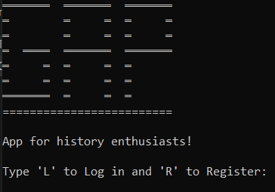
Let’s jump in!

