Slide 1


Linked Historians

Slide 2
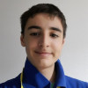
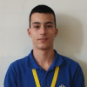
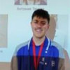
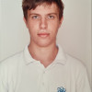
The Team
QA
Scrum Trainer
Front-End Developer
Back-End Developer
Ivaylo Lalev
Nedyalko Libchev
Nikolay Kulov
Kaloyan Ivanov

Slide 3
Our Objective
Our Objective is to create a database which is reliant on user input to add data involving historical events and details about people, places and timelines.
We seek to make the work of historians easier by letting them collect and organize all the information in one place

Slide 4







Technologies
Used

Slide 5
Let’s continue to the project…

