Slide 1

MASTERCODERS

Slide 2





Table Of Contents
Our team
The idea
Process
Used programs

Slide 3

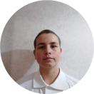
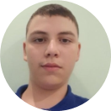

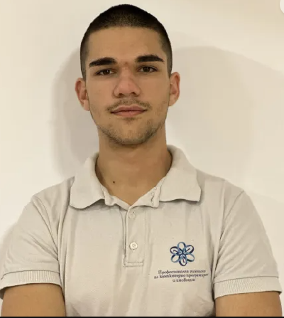
Our team
IVELIN VOYNOV- Scrum Trainer
DANIEL KOSTADINOV- QA Engineer
ALEXANDER LALEV- Backend Developer
LUCHEZAR RASHKOV- Frontend Developer

Slide 4

The idea
Our idea was to create an event organisation app with the help of C++

Slide 5

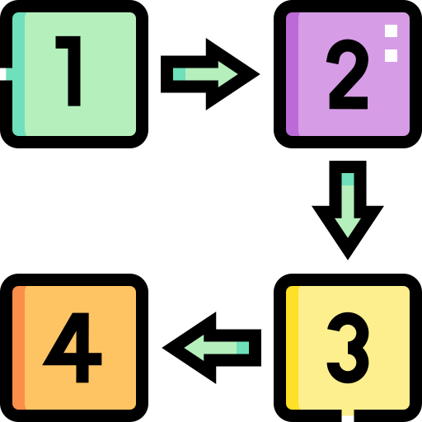

Process
Step at work.
Discussing the idea
Coding
Idea and explanation.
Work on the idea
Debugging
Realization
Troubleshooting the errors we have
Ways of implementation.

Slide 6







Used programs

Slide 7


Thanks
Let’s go to the app ...

