Slide 1



MBPHistory
Table of contents
01.
Team members
03. Main idea
02.
Main idea
04. Tech stack

Slide 2

Table of contents
MBPHistory
01.
Team members
03. Main idea
02.
Main idea
04. Tech stack

Slide 3
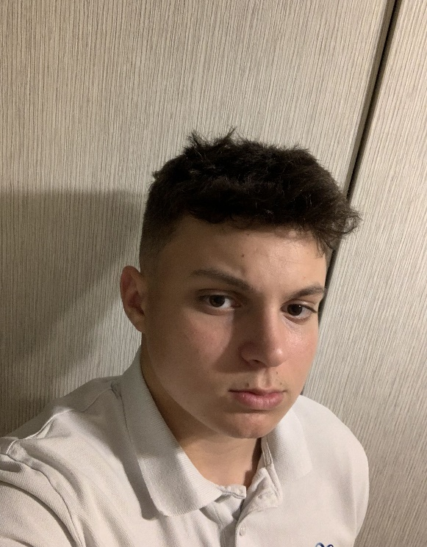
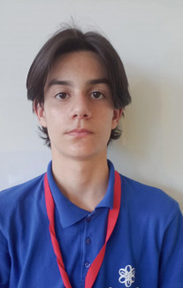



Team members
01
Милко Барев
Ивайло Гюров
Scrum trainer
Back-end developers
Кристян Димитров
Калоян Илиев
QA
Back-end developers

Slide 4
Team members
Timeline
Милко Барев
Ивайло Гюров
Scrum trainer
Back-end developers
Кристян Димитров
Калоян Илиев
QA
Back-end developers

Slide 5





Timeline
02

Slide 6

Timeline
Lastly
We did the documentation
Firstly
We discussed the main idea
Secondly
Our scrum gave us tasks and we started working on the application

Slide 7
Timeline
Lastly
We did the documentation
Firstly
We discussed the main idea
Secondly
Our scrum gave us tasks and we started working on the application

Slide 8
Timeline
Lastly
We did the documentation
Firstly
We discussed the main idea
Secondly
Our scrum gave us tasks and we started working on the application

Slide 9
Timeline
Firstly
We discussed the main idea
Lastly
We did the documentation
Secondly
Our scrum gave us tasks and we started working on the application

Slide 10

03
Main idea
Our mission was to create an easy-to-use application designed to help individuals and organizations manage historic events

Slide 11
Main idea
Our mission was to create an easy-to-use application designed to help individuals and organizations manage historic events
03

Slide 12










Tech stack
04

Slide 13

Tech stack

Slide 14
Now lets continue with the app!

