Slide 1



PastPulse

Slide 2
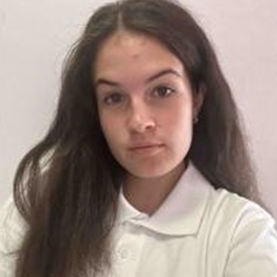
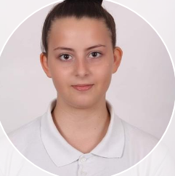
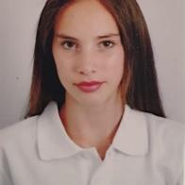
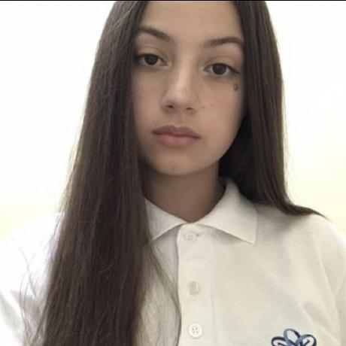
Our Team
Teodora Skulieva
Polina Dineva
Dimaya Noneva
Daniela Stoilova
SCRUM Trainer
Backend Developer
Frontend Developer
QA

Slide 3


Stages of creation
Come up with an idea
Work on the project
Testing and debugging

Slide 4

The idea…

Slide 5






Technologies

Slide 6

Let’s dive into the project!

