Slide 1
PointerX

Slide 2
Table of contents
01
Our team
02
The idea
03
Step at work
04
Technologies

Slide 3
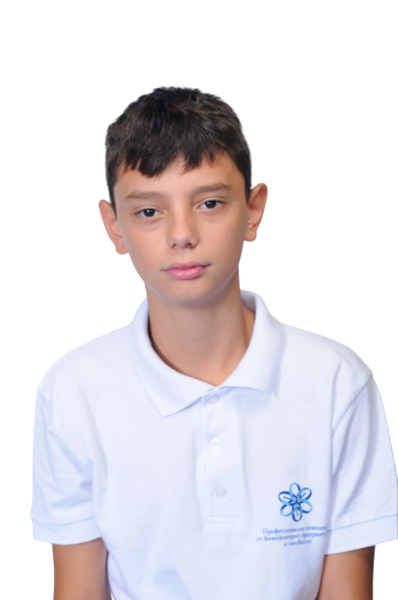
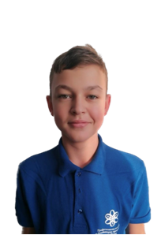
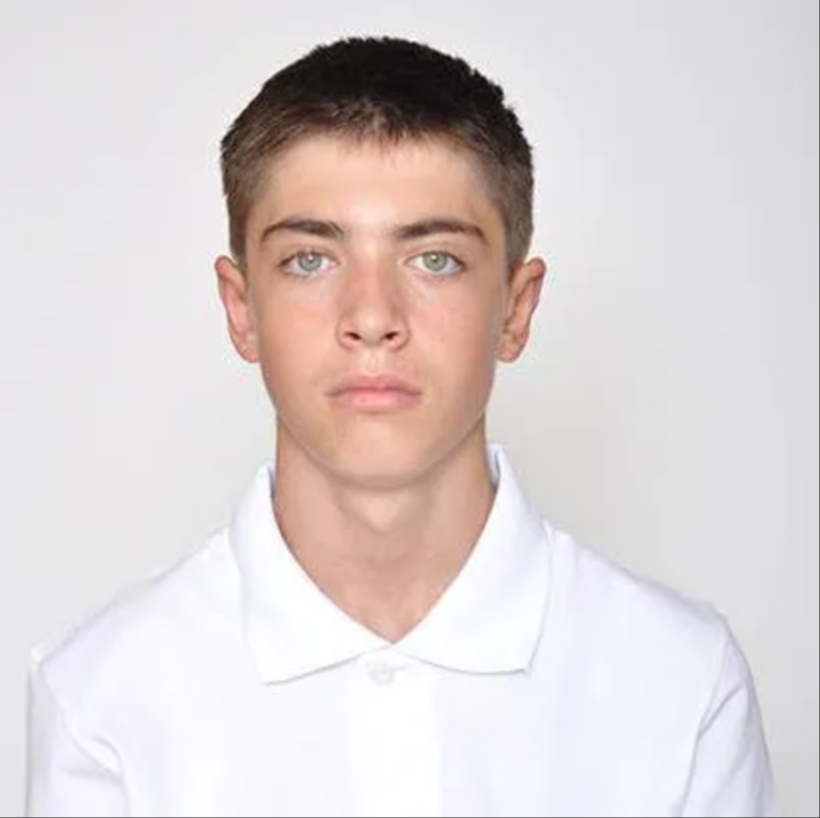
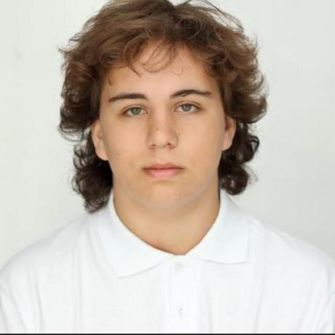
Our team
Asparuh
Georgiev
10G
Scrum Trainer
Georgi
Georgiev
10V
QA
Petar
Kostov
10G
Back-end Developer
Georgi
Stoyanov
10А
Front-end Developer

Slide 4

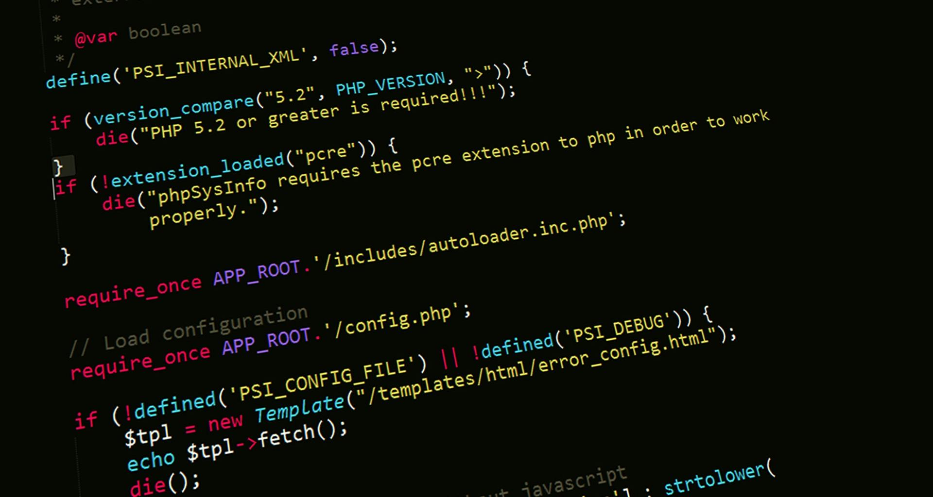
The idea
Development of an application for registering and managing historical events through linked lists in C++.

Slide 5

Our steps at work
Team
Idea
Used technologies
Realization

Slide 6






Technologies

