Slide 1



Slide 2


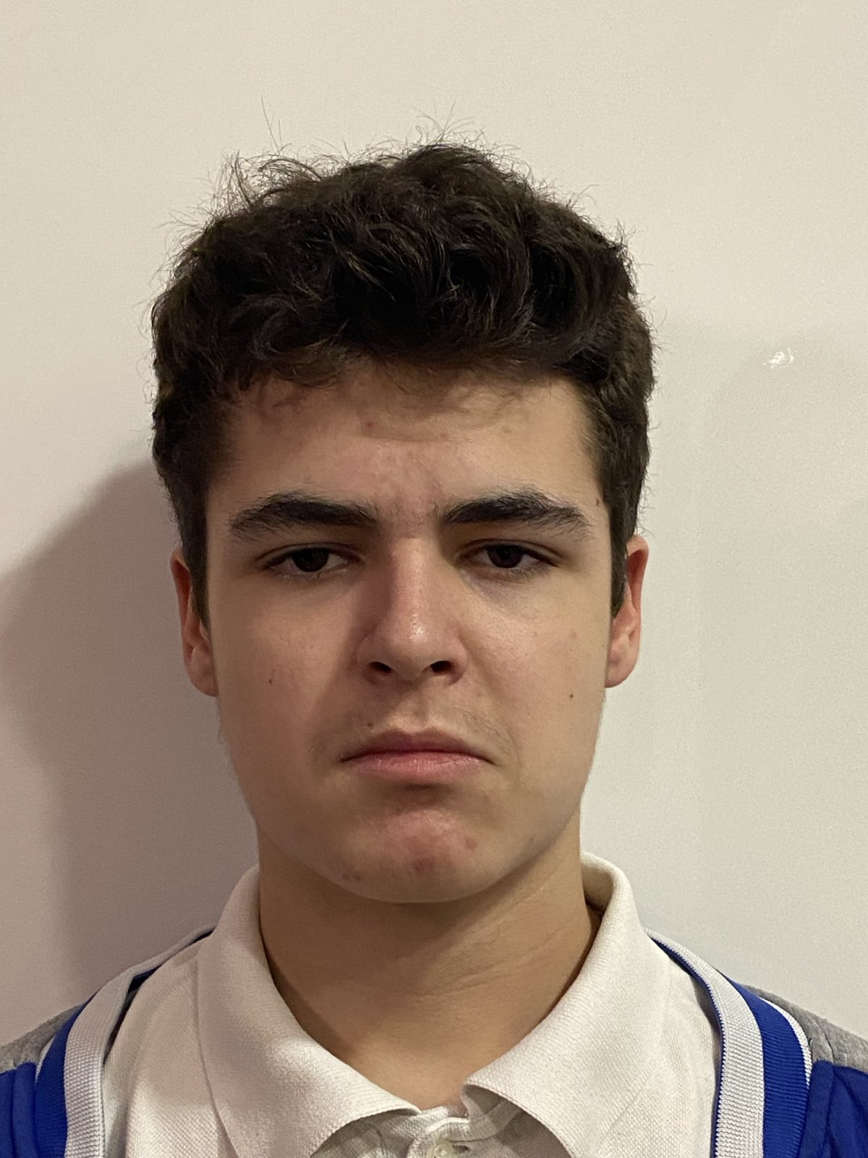

Our Team
Hristo Rusev
Martin Dimitrov
SCRUM-Trainer
Front-end developer
Ivan-Mihail Ivanov
Petur Dimitrov
Back-end developer
QA Engineer

Slide 3
Table of contents
01
02
03
04
Create the idea
Start coding
Make final touches
Realization

Slide 4
Introduction
This project is a console-based application designed to provide an interactive and informative experience about the key historical events that have shaped the nation of Bulgaria. The application will serve as an educational tool, offering users a detailed chronological overview of significant milestones, historical figures, and transformative moments in Bulgarian history.

Slide 5







Technologies

Slide 6
Let’s get to the application

