Slide 1

Time Vaulters

Slide 2
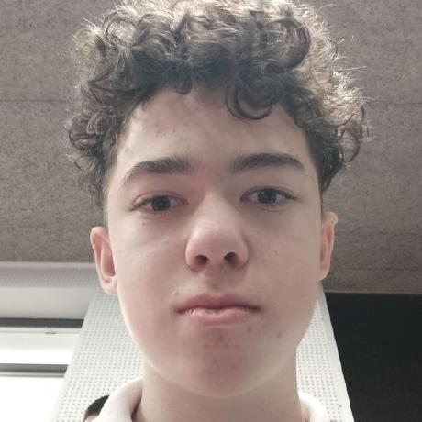
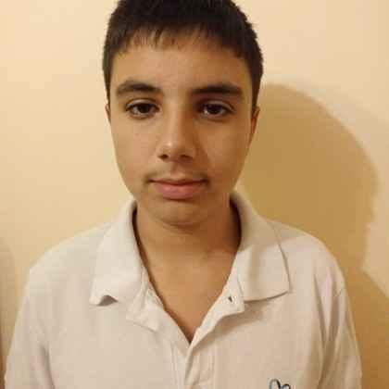
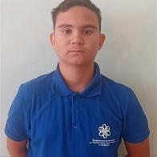
Our Team
Калоян Петров (Scrum Trainer, QA)
Антон Бабев (Frontend Developer)
Николай Желязков
(Backend Developer)

Slide 3
Idea
We had about two weeks to complete the project.
01
Our idea was to create a program that allows users to read about various historical events and customize them according to their own vision. Users could edit the name, date, and description of events, or even add entirely new ones.
02
At first, we weren’t completely sure how we were going to bring the idea to life. But as we continued working, the direction of the project became clearer, and things started to come together naturally.
03

Slide 4
Realization
How We Worked Together
Collaborated through online platforms and coding environments
Held regular meetings every 2–3 days to track progress and set new goals
What We Learned
Gained valuable experience as we worked
Saw the project improve steadily over time

Slide 5
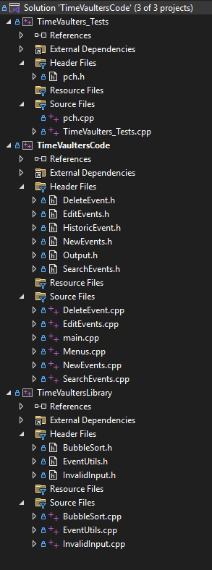
File Structure

Slide 6
Now Let's Jump Into The Project!

