Slide 1


Slide 2
Contents:
01
02
Our Team
Our goal
03
04
Stages of Realization
Used Technologies

Slide 3
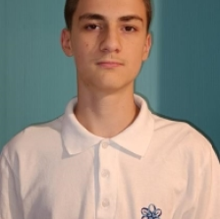
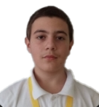
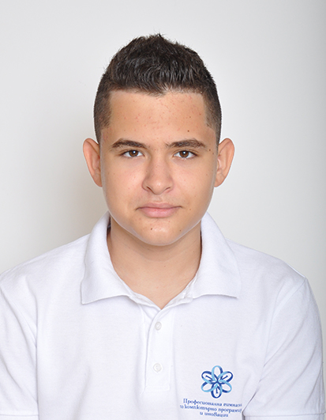
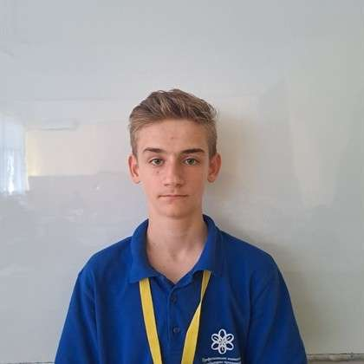
01 The Team
Tsvetan Zhekov
Velizar Mihailov
Martin Shavov
Stiliyan Dyulgerov
Scrum Trainer
Front-End Developer
Back-End Developer
Quality assurance

Slide 4
02 Our Goal
Our team decided to make a program for registering and managing historical events using linked lists with a text-based user interface. For this project we decided to use C++ as a programming language.

Slide 5
03 Stages of Realization
Organization
Decide on the idea
Development
Presentation

Slide 6








04 Used Technologies

Slide 7
Thank you for your attention!

