Slide 1


Slide 2
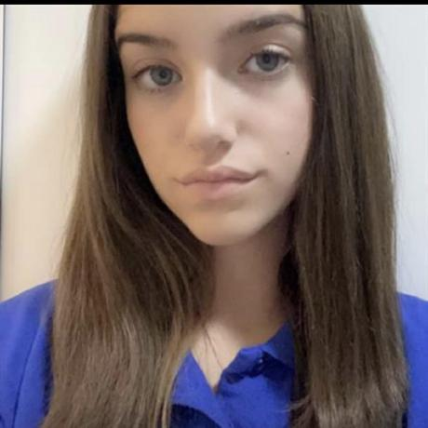


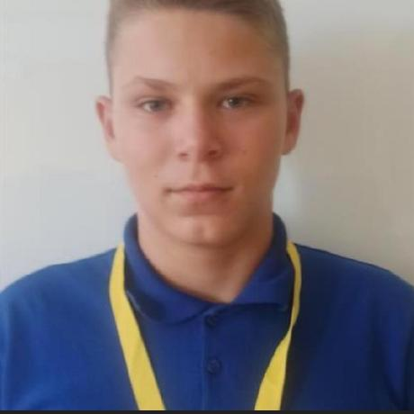

OUR TEAM
Veselina Varadeva
SCRUM Trainer
Jaklin Yankova
Front-end developer
Gabriela Encheva
Back-end developer
Lachezar Gospodinov
QA

Slide 3

STAGES OF CREATION
Come up
with an idea
Work on the project
Testing and debugging

Slide 4
THE IDEA
Timelock is a C++ application for registering and managing historical events, organized by eras using linked lists. Users can add, edit, search, and delete events, each containing details like title, topic, place, participants, and outcome. It features a clear console menu, user roles, data validation, and a well-structured codebase for maintainability and testing.

Slide 5






TECHNOLOGIES

Slide 6
LET’S DIVE INTO THE PROJECT!

