Slide 1



TIMESTACK

Slide 2



TABLE OF CONTENTS
01
03
STAGES OF
REALIZATION
OUR TEAM
02
04
APPLICATIONS
AND SOFTWARE
OUR IDEA

Slide 3
01
OUR TEAM

Slide 4
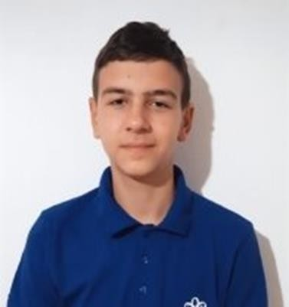
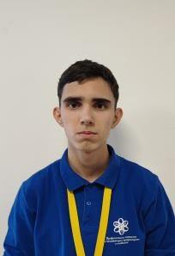
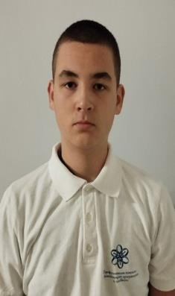
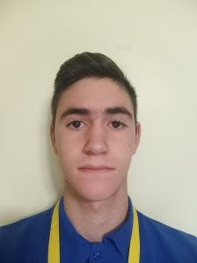
Nikolay Zhelev 10G (Scrum Trainer): Coordinates team, plans tasks, manages GitHub project
Simeon Kalamarev 10A (Frontend Developer): Designs console navigation
and visual aspects
Yuan Tomov 10G (Backend Developer): Develops code structure, manages files
Borislav Petkov 10A (QA): Conducts tests, identifies bugs, ensures quality

Slide 5
02
OUR IDEA

Slide 6


To develop a C++ console application that allows users to manage historical events effectively.
To apply classroom knowledge to a real-world inspired
project, enhancing both technical and soft skills.
To encourage historical learning through interactive features such as event quizzes and smart search tools.
To work collaboratively in a team setting using modern
development practices and tools.
Deliver a fully functional program that meets all planned requirements (add, edit, delete, search, sort, quiz, export).
Ensure code reliability and usability through quality
assurance and testing practices.
Submit a well-documented and professionally presented project that demonstrates both technical proficiency and teamwork.
Create a foundation for potential future expansion,
including the possibility of a graphical interface or
database integration.
OUR AIM
THE GOAL

Slide 7
03
STAGES OF REALIZATION

Slide 8

1. Technical Realization We created a
structured C++
console app with key features like search, sort, export, and quizzes, ensuring stable performance through testing.
2. Teamwork Realization Using Scrum, we
worked efficiently in
defined roles, communicated through Discord and Teams, and collaborated via GitHub.
3. Educational Realization We applied classroom
knowledge in a real project, developed teamwork and problem-solving skills, and built something we're proud of.

Slide 9
04
APPLICATIONS AND SOFTWARE

Slide 10









VISUAL STUDIO
EXCEL
WORD
TEAMS
DISCORD
CANVA
POWERPOINT

Slide 11
LET'S SEE THE PROJECT

