Slide 1
Valid
Valid

Slide 2
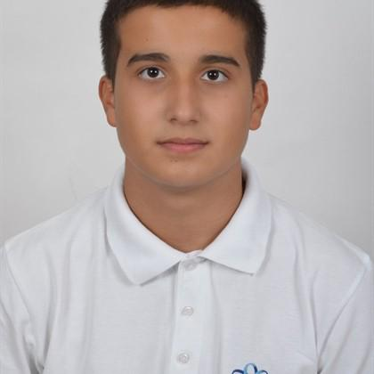
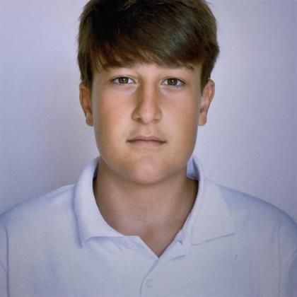
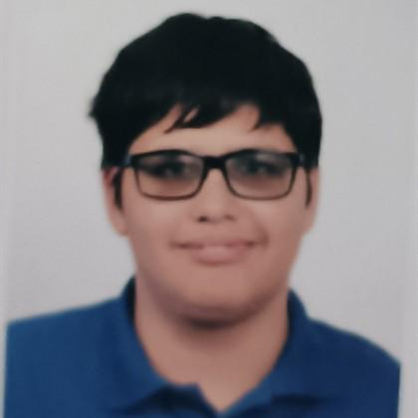
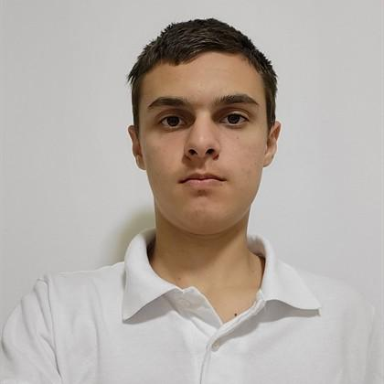
Team presenturs
Nikolay Yanakiev 10V QA
Ivan Ivanov 10B FrondEnd Developer
Maxim Mateev 10B​
Scrum Trainer​
Veselin Todorov 10
BackEnd Developer​

Slide 3






Used applications
Valid

Slide 4
Let’s have a look
• Our project is a console application, that make it easy and understandable for the people who are learning History, so they can have better general knowledge for events where Bulgaria won, because nowadays is important to be representative.

Slide 5
With that being said, let's move on into the project.

