Slide 1


Cinema management system

Slide 2
Table of contents
01
About me
03
My idea
02
Stages of creation
A brief overview of who am I
Description of my concept.
Detailing the progression of our creation process.

Slide 3
01
About us
Our essence.

Slide 4
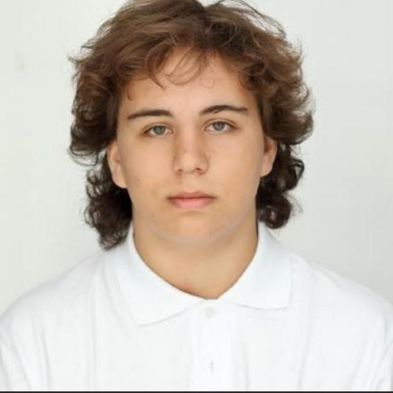
About me

Slide 5
Stages of creation
02

Slide 6
Our stages
Create the design
Implement the functions and test the app
Come up with the idea
Implement the design
Create the presentation and documentation

Slide 7
03
Our idea

Slide 8
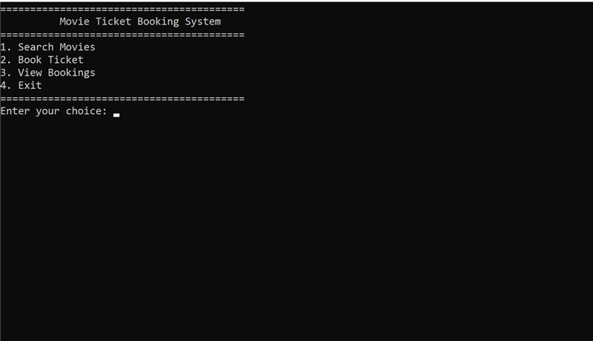
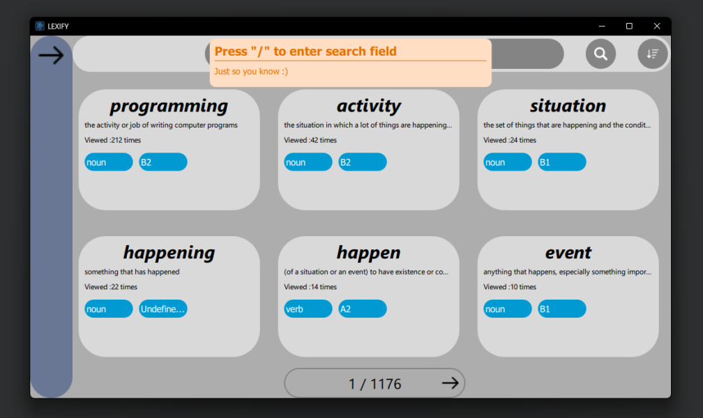
Our concept
My app is a console-based movie ticket booking system where users can browse movies, book seats, and manage their reservations. Admins can add, update, and delete movies, as well as manage other admins through a secure panel. All data is stored in text files for simplicity and easy access.

Slide 9
Lets jump to the app!

