Slide 1
Bsac

Slide 2
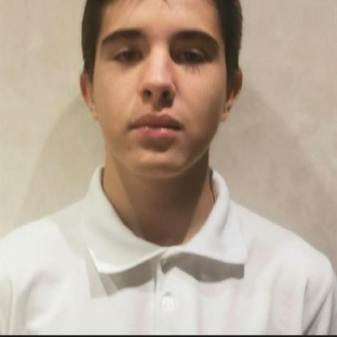
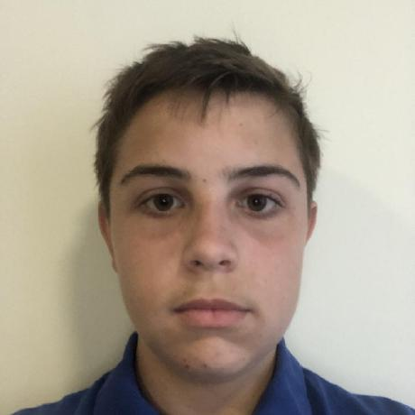
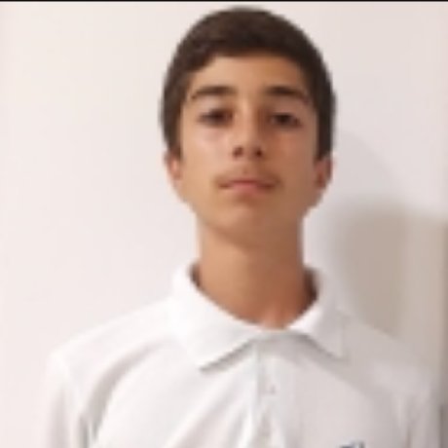
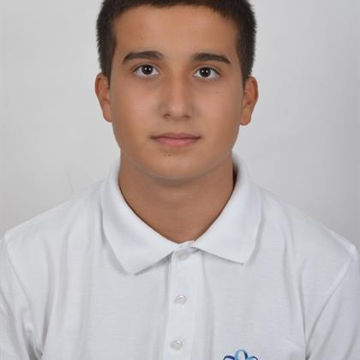
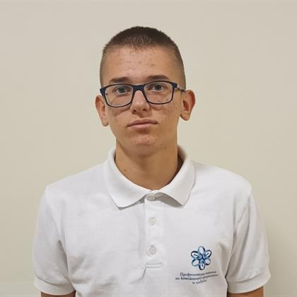

Our Team​
Martin Nenkov
[ Back-End Developer]
Stoyan Skuliev
[ Scrum Trainer ]
Apostol Kupenov
[ Back-End Developer]
Ivan Ivanov
[ QA Developer ]
Stefan Dimitrov
[ Front-End Developer ]
Mitko Doychev
[ Front-End Developer ]

Slide 3
About the project​
Our project is a console application, that make it easy and understandable for the students to learn new information about the basic subjects in school, so they can have better general knowledge.

Slide 4
Stages of realizations
1. Distribute the roles
2. Invent an idea
3. Realization of the idea
4. Present the project

Slide 5








Used Technologies

Slide 6
Now let's jump to the project!

