Slide 1
Bsac

Slide 2
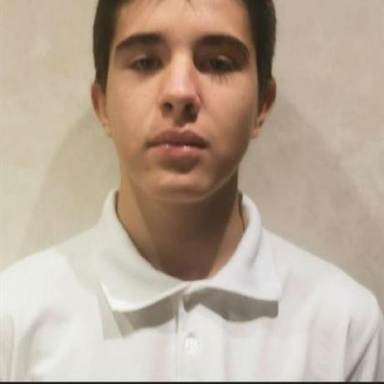
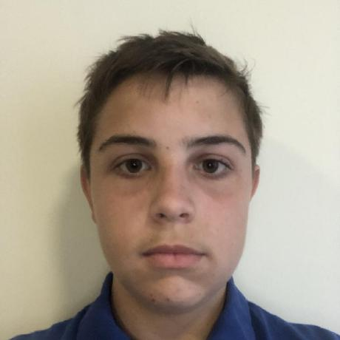
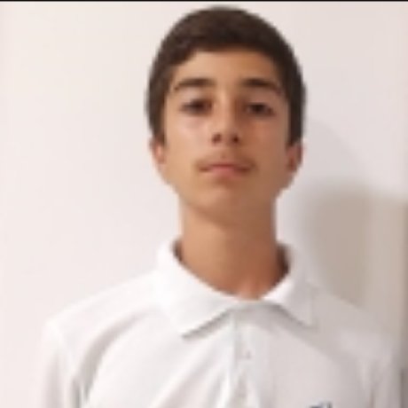
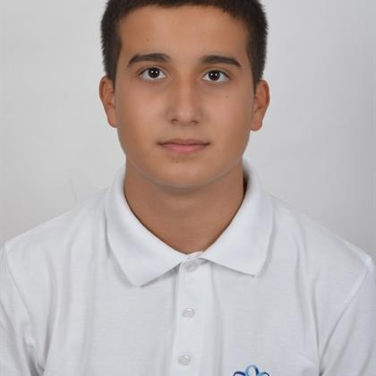
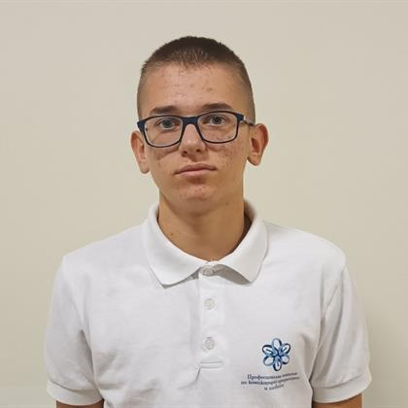

Our Team​
Martin Nenkov
[ Back-End Developer]
Stoyan Skuliev
[ Scrum Trainer ]
Apostol Kupenov
[ Back-End Developer]
Ivan Ivanov
[ Designer ]
Stefan Dimitrov
[ Front-End Developer ]
Mitko Doychev
[ Front-End Developer ]

Slide 3
About the project​
Our project is a console application, that make it easy and understandable for the students to learn new information about the basic subjects in school, so they can have better general knowledge.

Slide 4








Used Technologies

Slide 5
Now let's jump to the project!

