Slide 1

Caveman Lawyers

Slide 2


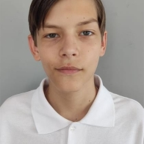

About us:
Anastasya Gorska -Programmer
Borislav Petkov -Programmer
Grigoriy Kalashnik - Q&A
Evgeniy Kresnov -Scrum

Slide 3
Our idea
Our project is about a test, where you need to choose a subject, and answer questions about it. Then, after answering you get a grade. If it is good enough you pass the test.

Slide 4






Used programs:

Slide 5
Now let`s check out the project

