Slide 1

Caveman Lawyers

Slide 2


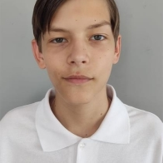

About us:
Programmer
Programmer
Q&A
Scrum

