Slide 1

Brainstorm By codeX

Slide 2
Table of contents
01
02
Our team
Stages
03
04
Technologies
The project

Slide 3
Stages of work
Stage 1
Stage 2
Stage 3
Stage 4
We created our logo and discussed ideas about the app.
We made the basic design of the app and created our login/register form.
We started implementing our app idea through code
The last week we have been focusing on finishing the app and the documentation.

Slide 4
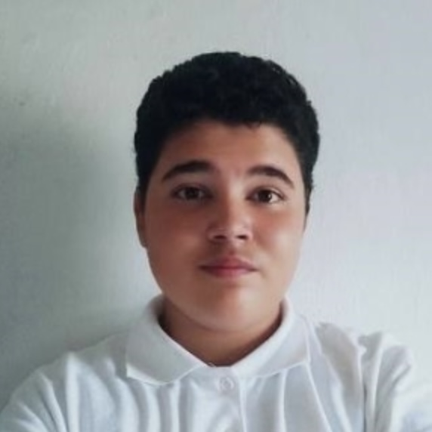
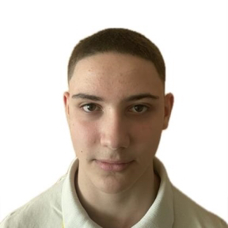
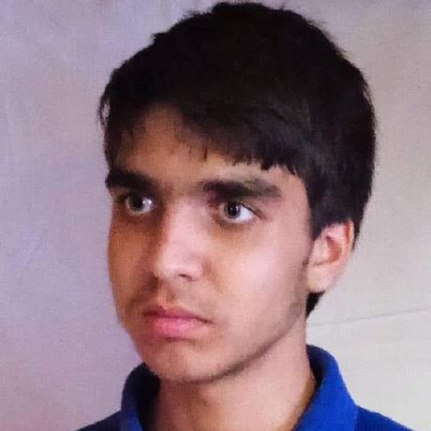
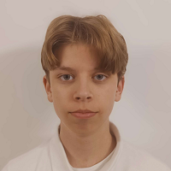
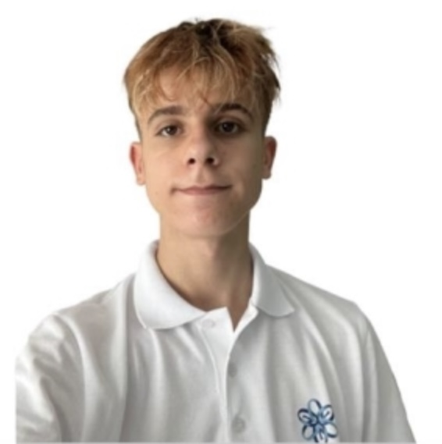
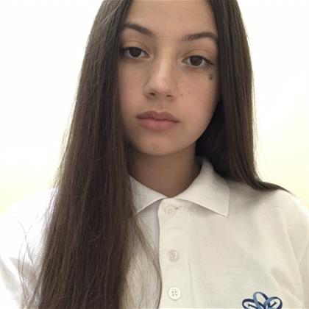
Our team
Bozhidar Dimov
Back-End Developer
Boris Milev
Back-End Developer
Gospodin Radev
Back-End Developer
Daniela Stoilova
Scrum Trainer
Nikolai Kalashnik
Back-End Developer
Kristian Gaydov
QA Engineer

Slide 5








The technology we used
MS Word
MS Excel
Power Point
MS Teams
Git Hub
Heidi SQL
VS Code
QT Creator

Slide 6

Let’s get to the app!

