Slide 1
CODIFY
Our educative app

Slide 2
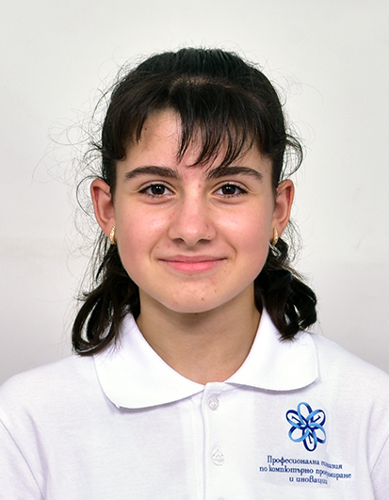
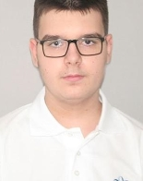
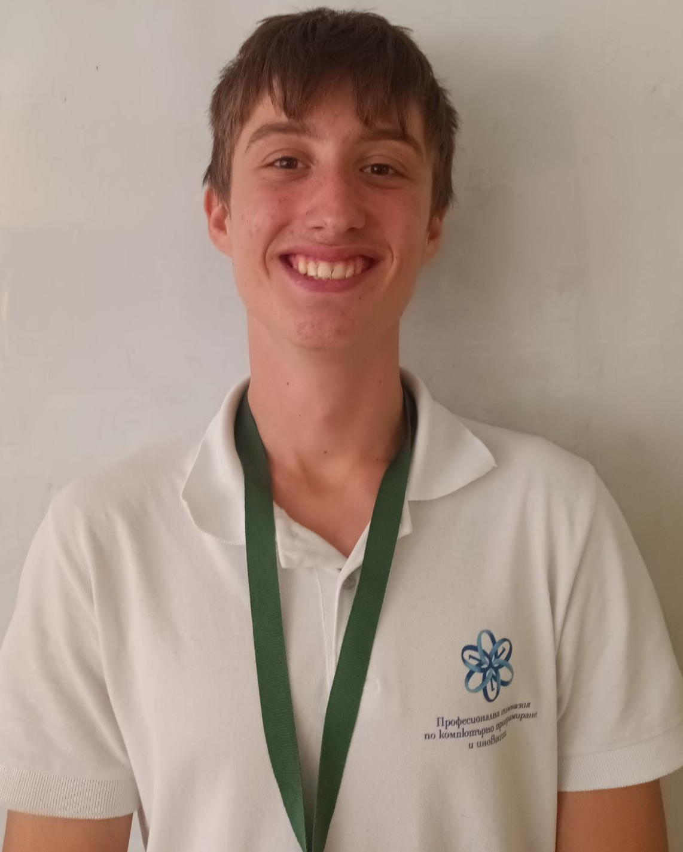
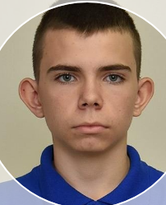
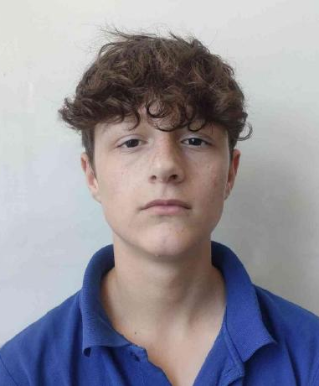
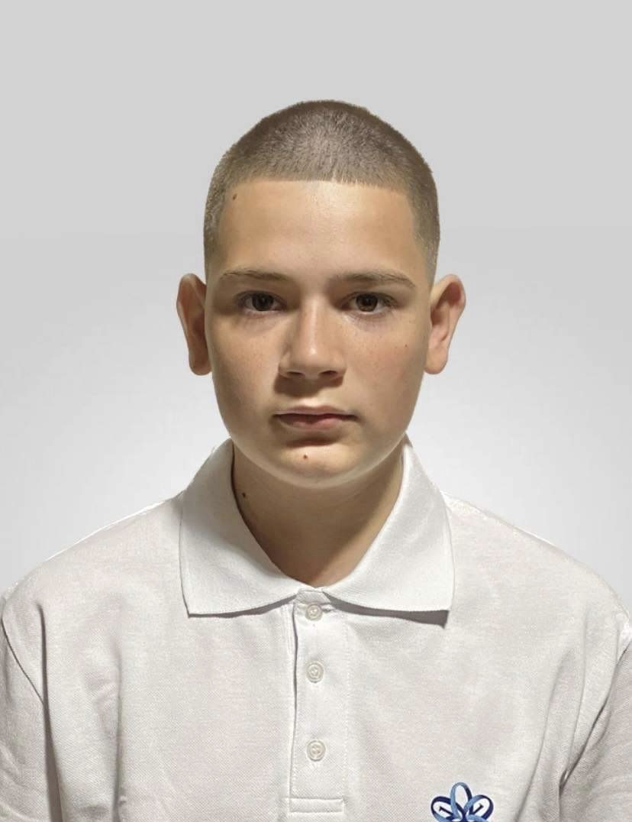
OUR TEAM
Iva Nedkova
Scrum trainer
Todor Ivanov
Back-end Developer
Bozhidar Dukov
Back-end Developer
Konstantin
Nachev
Back-end Developer
Dimitar Kostadinov
Back-end Developer
Plamen
Petkov
QA

Slide 3

OUR IDEA
Our idea is to create a platform where students can improve their knowledge in different subjects.

Slide 4
STAGES OF REALIZATION
We chose the name of the team
We assigned roles
We created the logo
We wrote the code for the app
We created the README.md file
We created the presentation and the documentation

Slide 5










USED TECHNOLOGIES

Slide 6
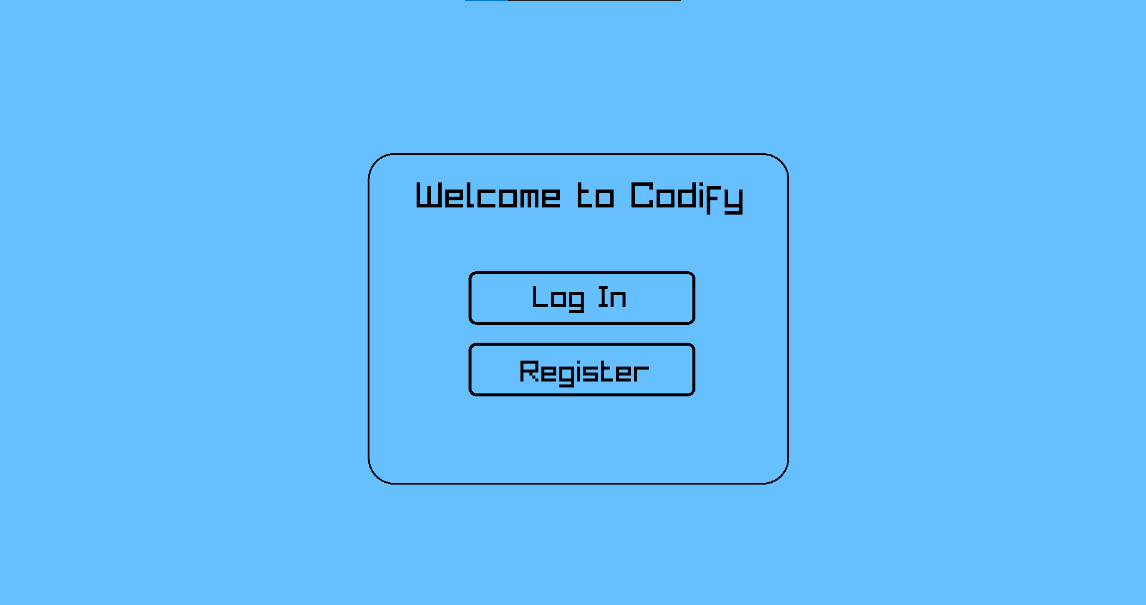
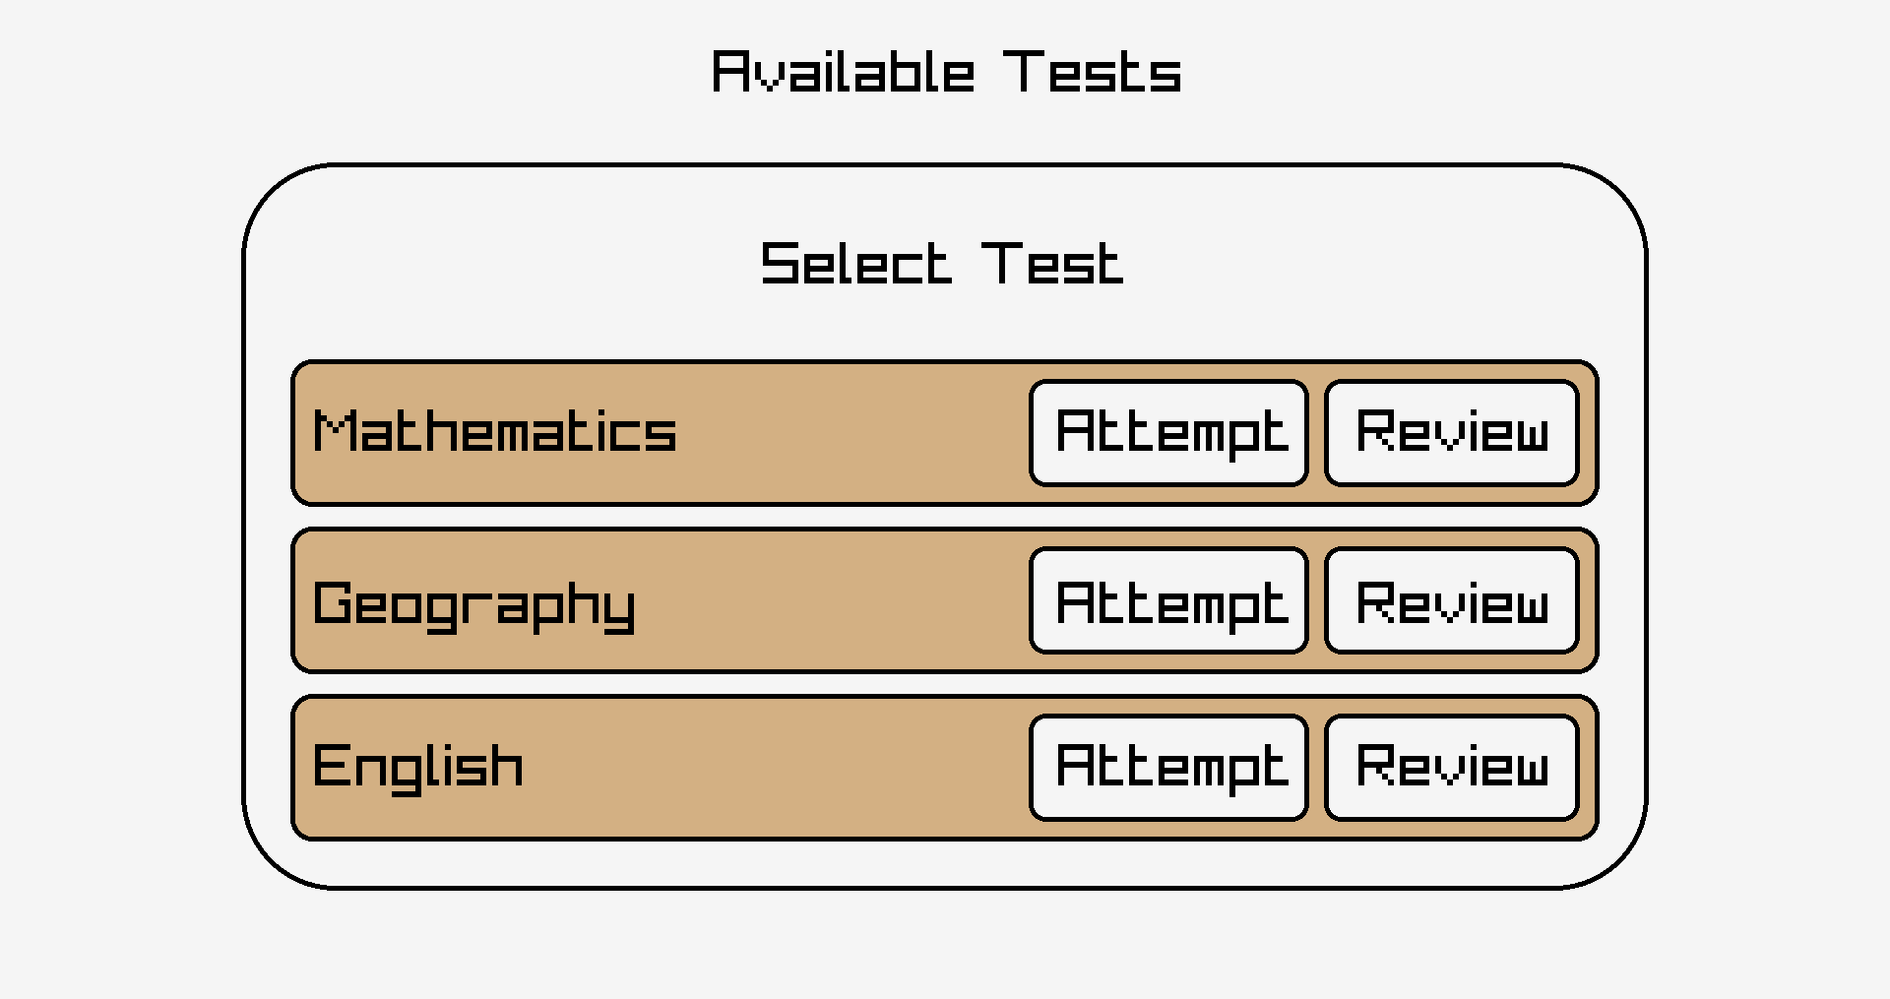
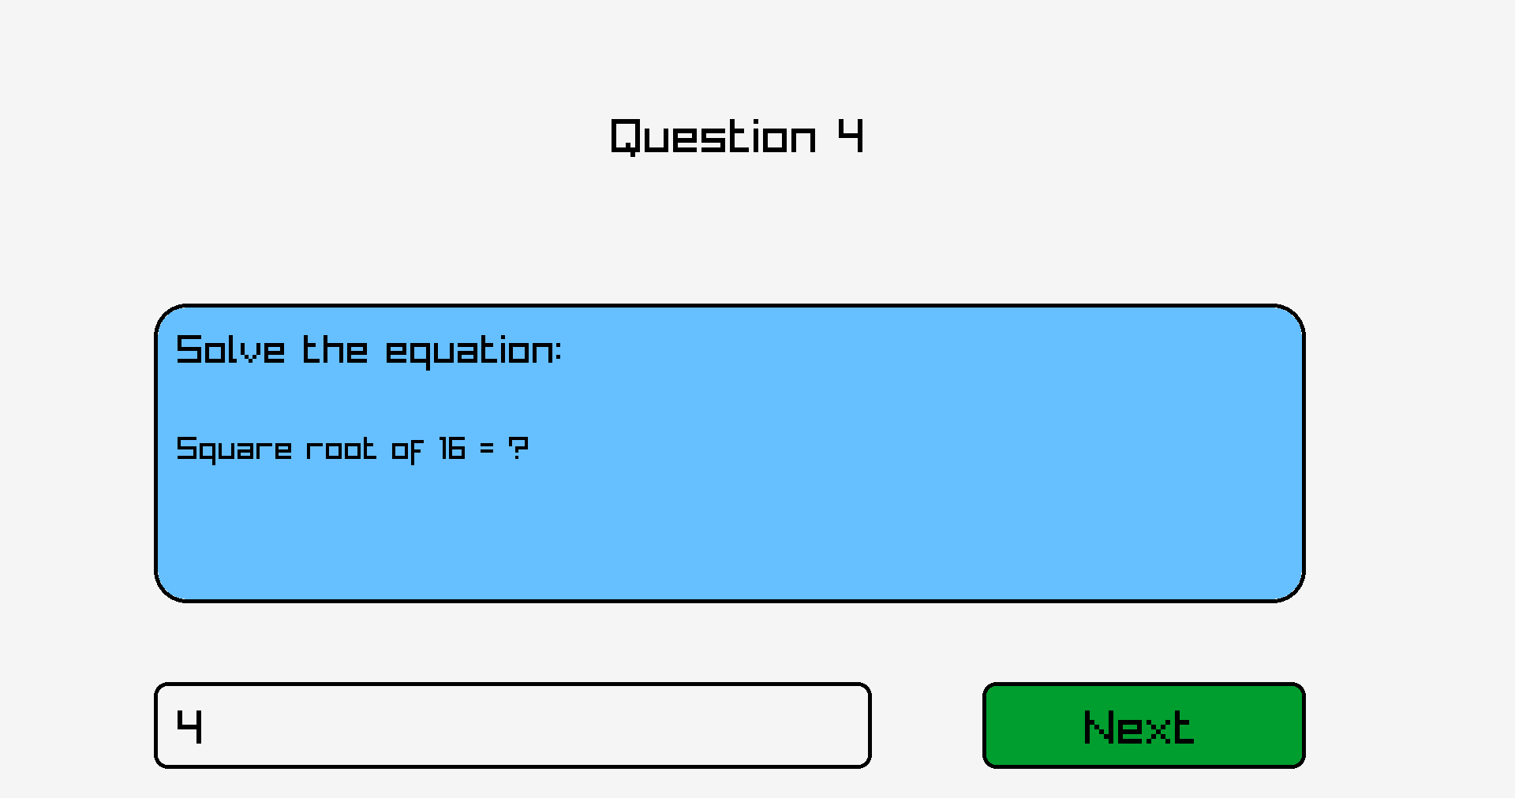
DEMO OF OUR PROJECT

Slide 7
Now let us guide you to our repository!

