Slide 1
TEAM -ETS-
Project on topic “E-School”

Slide 2
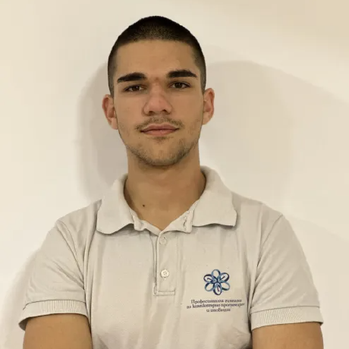
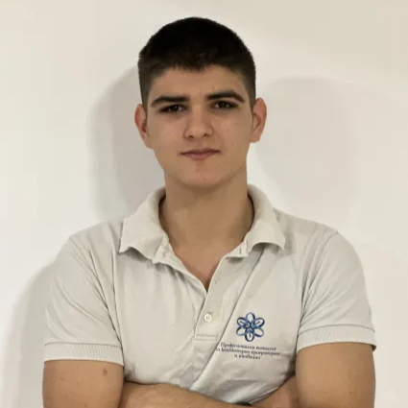
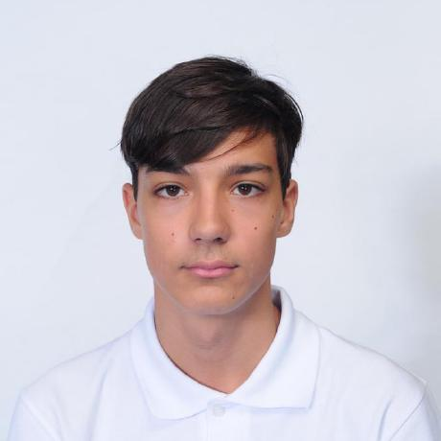
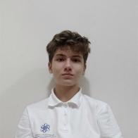
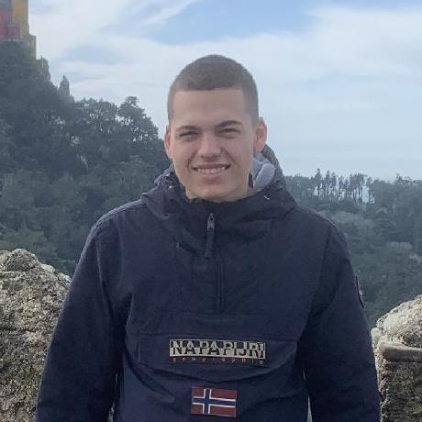
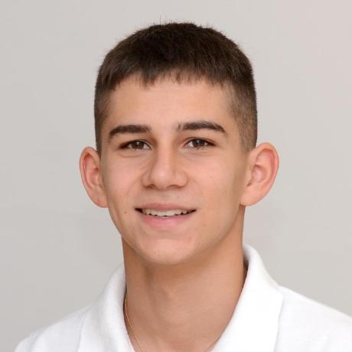
Our team:
Lachezar Rashkov
Dean Petkov
Anton Kabakov
Aleks Kazakov
QA
Scrum trainer
Developer
Developer
Todor Atansov
Ivan Dochev
Developer
Developer

Slide 3
Stages of Development
01.
Brainstorm the idea
03.
Development
02.
Design creation
04.
Presenting
The most important aspect of a project is the idea.
Create the basic C++ structure.
Make the design
Final Stage - Presentation in front of judges.

Slide 4









The technology we used

Slide 5
Let’s jump to the project

