Slide 1
The Scholars

Slide 2
Contents
1. Our team
2. Our goal
3. The Realization
4. Used technologies

Slide 3
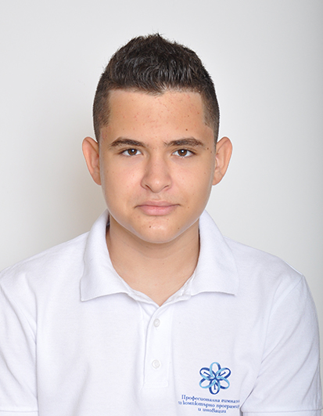



Our team
Мартин Шавов
Scrum Trainer
Велизар Михаилов
Developer
Веселин Найденов
developer
Антон Бабев
Developer

Slide 4
Goal
For us, the most important thing is to help students access the potential in their skills and give them the best way to learn and unlock it.

Slide 5
The Realization
The Idea
Work Distribution
Working on the Project
Documentation
Presentation

Slide 6




Used technologies

Slide 7
Thank You!

