Slide 1

IceFlow

Slide 2





Table Of Contents
Our team
The idea
Process
Used programs

Slide 3

Our team
Ivelin Voynov 9V - Scrum Trainer
Stilian Georgiev 10G - QA Engineer
Alexander Lalev 9V - Backend Developer
Daniel Kostadinov 9V - Backend Developer
Emma Georgieva 10B - Backend Developer
Kristiyan Kostadinov 10G - Backend Developer

Slide 4

The idea
Our idea was to create a powerful exam simulation with the help of C++

Slide 5

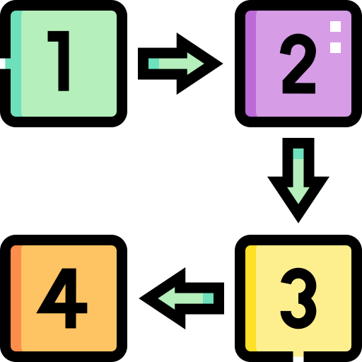

Process
Step at work.
Discussing the idea
Coding
Idea and explanation.
work on the idea
Debugging
Realization
Troubleshooting the errors we have
Ways of implementation.

Slide 6






Used programs

Slide 7


Thanks
Let’s go to the app ...

