Slide 1

Insight

Slide 2
Table of Contents
01
-
Team members
02
-
Topic
03
-
Stages of realization
04
-
Used technologies

Slide 3
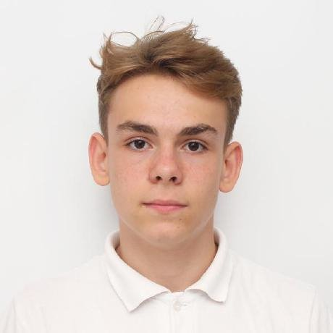
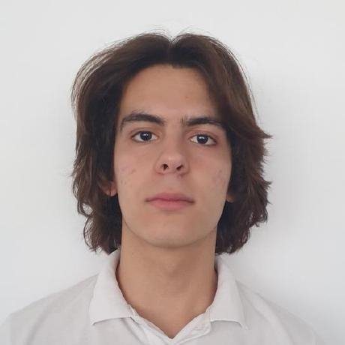
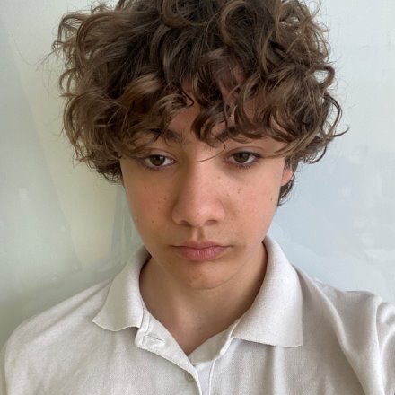
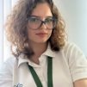
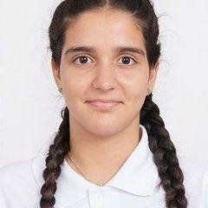
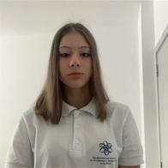
Team members
Zarko Vladkov – 9b
Dimitar Dimov – 10g
Boyan Kyovtorov – 10v
Back-end Developer
Back-end Developer
Back-end Developer
Kristiyana Hristova – 9v
Demetra Karagyozova – 10g
Ioana Georgieva- - 9b
Front-end Developer
Scrum trainer
Front-end Developer

Slide 4
Topic
We're building a platform similar to our school's quiz system. On this platform, users can create and do quizzes with their own profiles. They can also change their account details or remove their account. This will help simplify the process of grading students.

Slide 5
Stages of realization
1
3
4
1
2
2
3
4
Thinking of an idea
Organizing and giving everyone a role
Realization
Presenting the final result

Slide 6










Used technologies

Slide 7
Let’s jump into the project!

