Slide 1

Insight

Slide 2
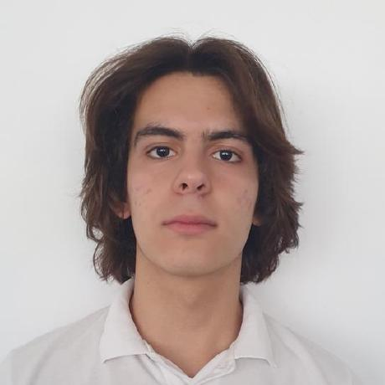
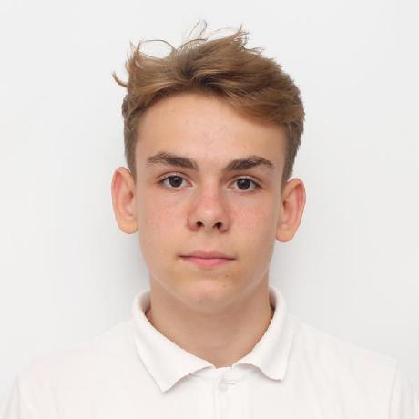
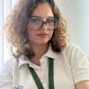
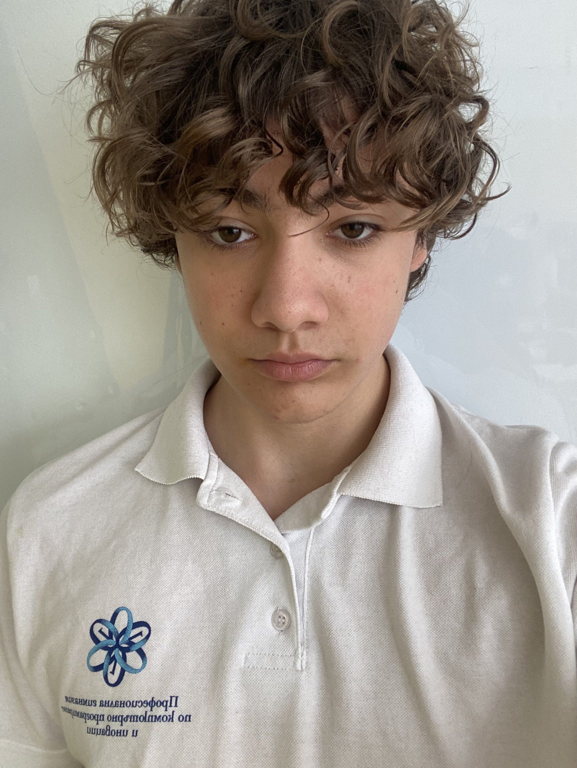
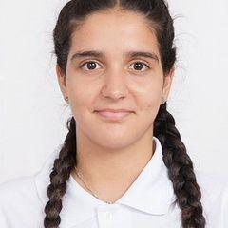
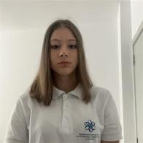
Our team
Dimitar Dimov 10G
Zarko Vladkov 9B
Kristiyana Hristova 9V
Boyan Kiovtorov 10V
Demetra Karagyozova 10G
Yoana Georgieva 9B

Slide 3
Our idea
We're building a platform similar to our school's quiz system. On this platform, users can create and do quizzes with their own profiles. They can also change their account details or remove their account. This will help simplify the process of grading students. In the planning stage, we came up with the idea for our project. We started with a platform designed for making quizzes on different subjects and later added features for creating, accessing, and deleting accounts.

Slide 4










Used Technologies

Slide 5
Let’s jump into the project!

