Slide 1
NERDS

Slide 2
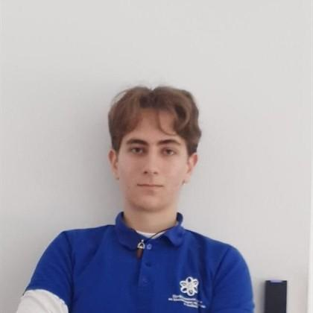
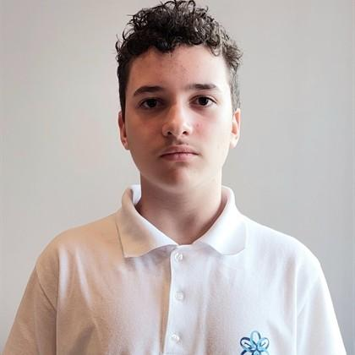
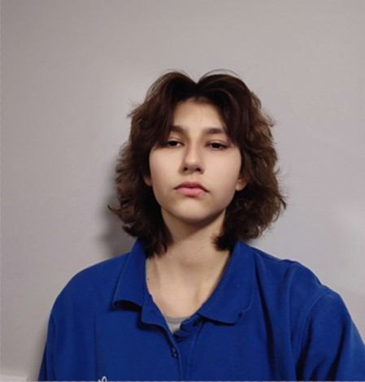
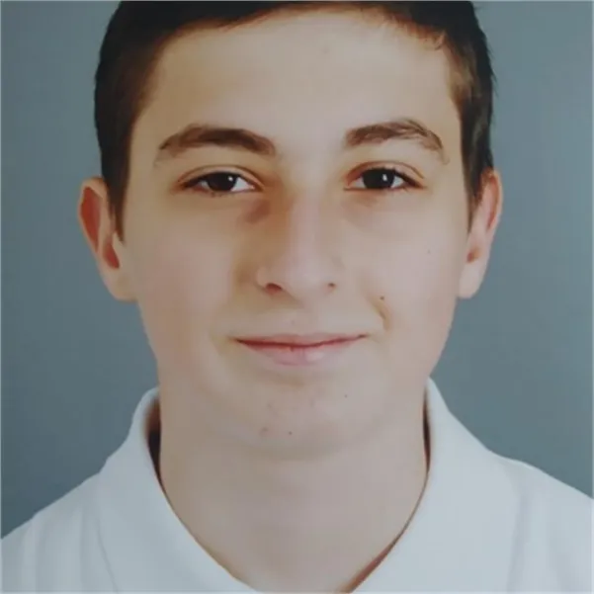
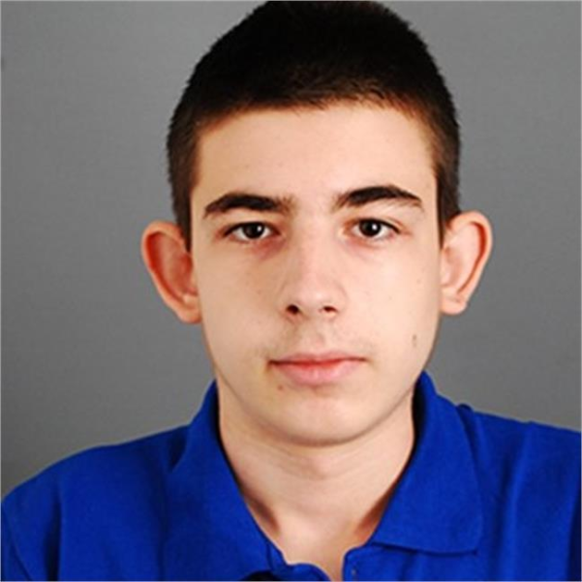
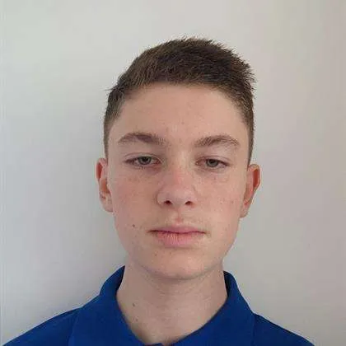
OUR TEAM
Мартин Миленов Стоянов 10б
Габриел Григоров Димитров 10в
Теодора Лъчезарова Лозева 10а
Петър Петров Димитров 9г
Мартин Емануилов Димитров 9г
Виниченко Олександр Олександров 9г

Slide 3
IDEA
We wanted to create an app which helps you in whatever subject you want by asking a chatbot your problem and the bot gives you the solution.

Slide 4
TASK
REALIZATION
TEST
ORGANIZATION
PRESENT

Slide 5






USED TECHNOLOGY

Slide 6
LET’S MOVE TO THE APP

Slide 7
THANK YOU FOR YOUR ATTENTION
Do you have any questions?

