Slide 1
NERDS

Slide 2
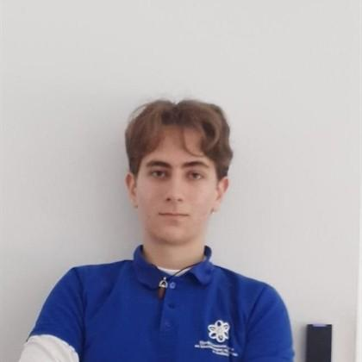
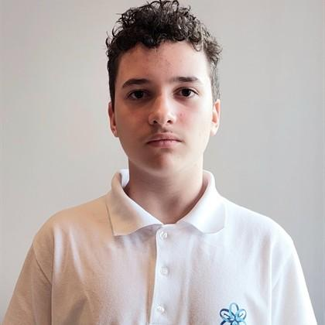
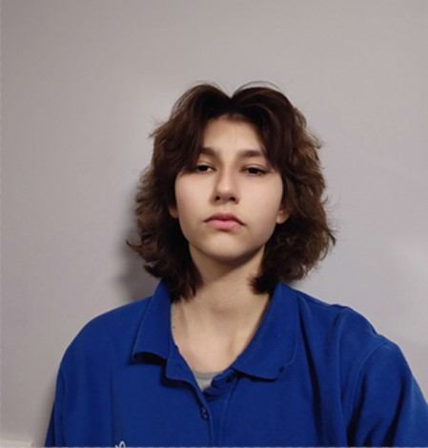
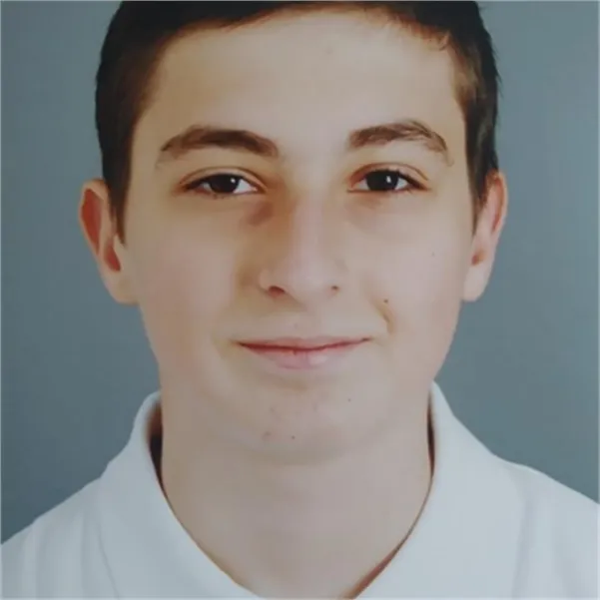
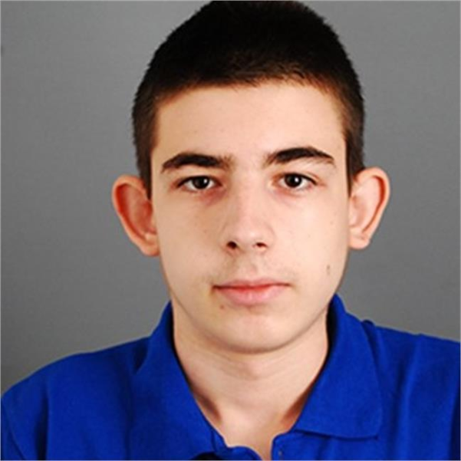
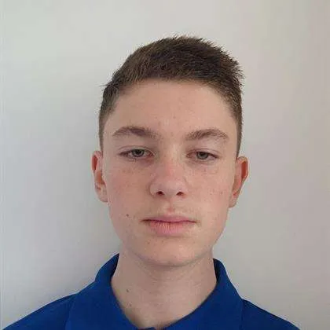
OUR TEAM
Мартин Стоянов 10б
Габриел Димитров 10в
Теодора Лозева 10а
Петър Димитров 9г
Мартин Димитров 9г
Виниченко Олександров 9г

Slide 3
IDEA
We have developed an app that assists users in a chosen school subject by providing explanations through a chatbot.

Slide 4
Stages
TASK
REALIZATION
TEST
ORGANIZATION
PRESENT

Slide 5






USED TECHNOLOGY

Slide 6
LET’S MOVE TO THE APP

Slide 7
THANK YOU FOR YOUR ATTENTION

