Slide 1

Online Academy

Slide 2
TABLE OF CONTENTS:
01 Our team
02 Our idea
03 Stages of realization
04 Used technologies

Slide 3
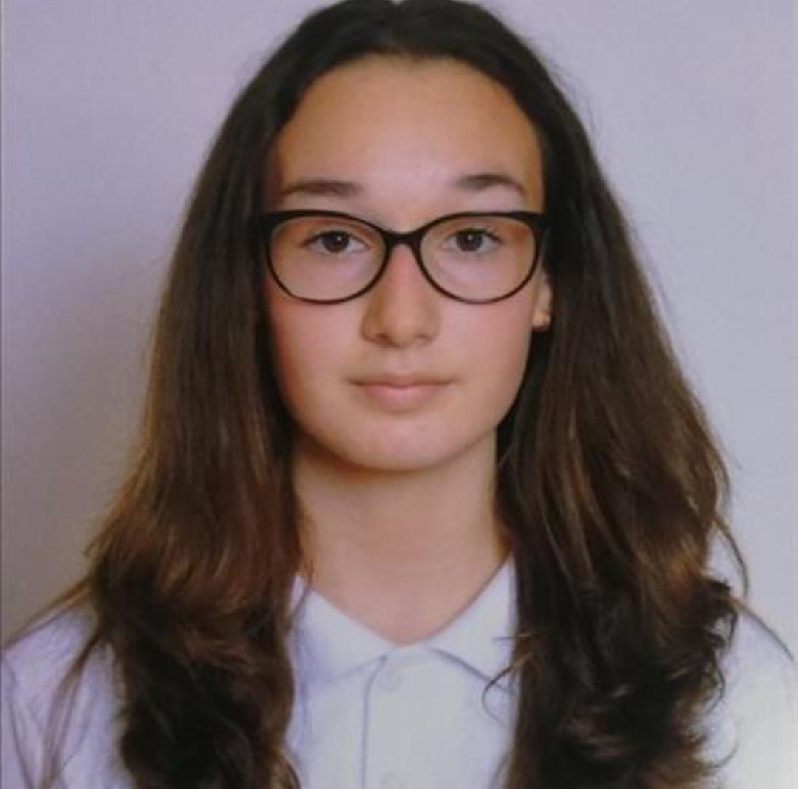
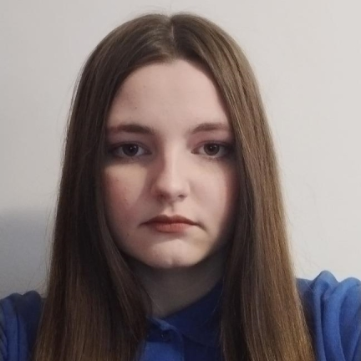
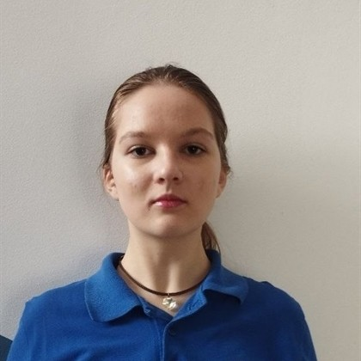
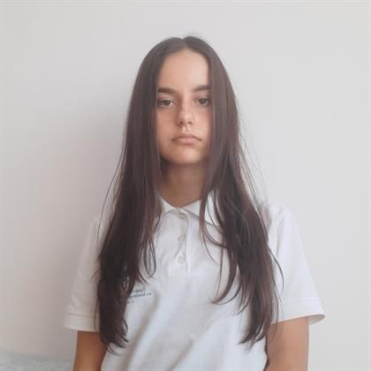
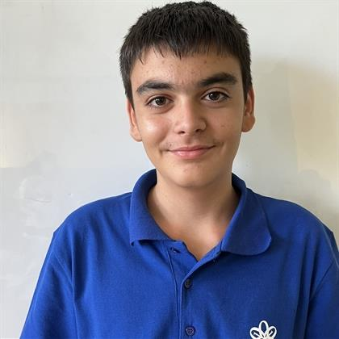
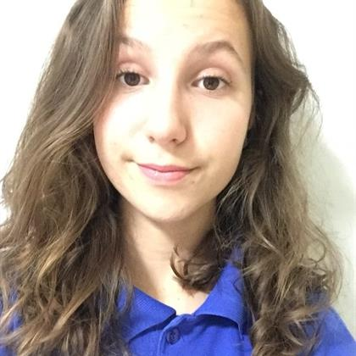
Our team
Viktoria Kupenova Scrum Trainer
Arina Popova
Back-end Developer
Maria Bakumtseva Back-end Developer
Yana Ilcheva
Back-end Developer
Rostislav Nikolov
Back-end Developer
Alexandra Zheleva
QA Developer

Slide 4
Our idea
The main idea of our app is to help you study and prepare for the final exams in your school.

Slide 5
Stages of realization
Organization
Decide on the idea
Development
Presentation

Slide 6






Used technologies

Slide 7
Thank you for your attention!

Slide 8
Let’s move on to the app!

