Slide 1

RedWood

Slide 2
Contents
About us
Our team
Tech Stack
Implementation

Slide 3

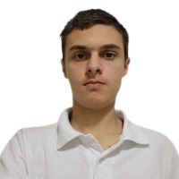
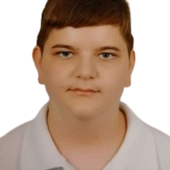
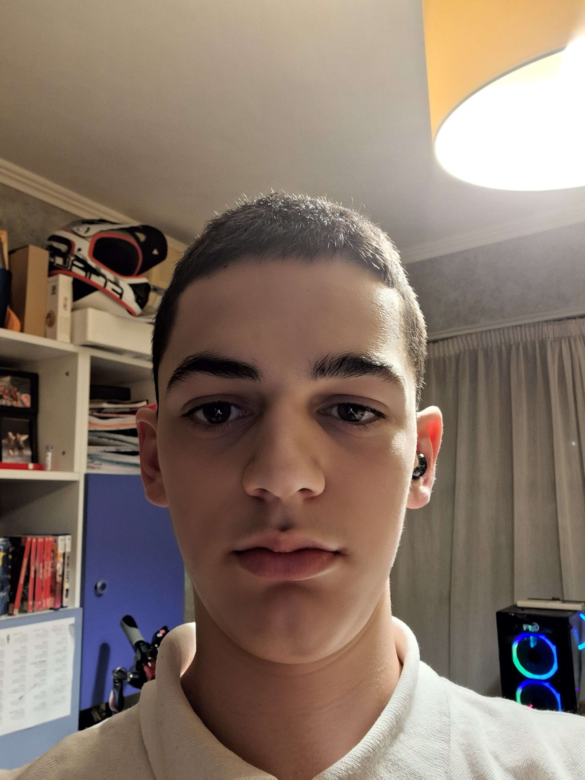
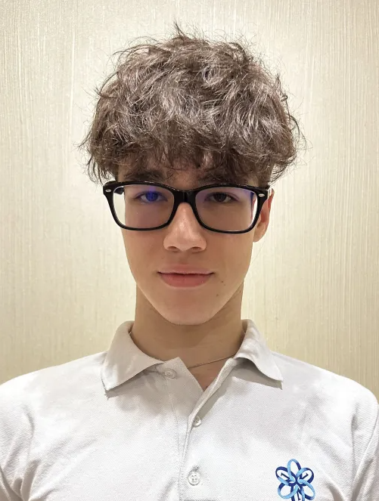
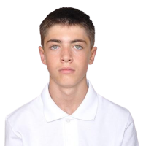
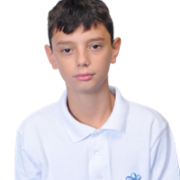
Our team
Nikolay Qnakiev
Back-end Developer
Kristian Rusev
Back-end Developer
Boris Rusinov
Back-end Developer
Alex Semerdzhiev
Scrum Leader
Georgi Stoyanov QA Developer
Georgi Georgiev Back-end Developer

Slide 4
The idea
The goal of our project is to make something fun that can educate you .

Slide 5






Tech Stack
Tech Stack

Slide 6
Thanks for listening!
Let’s jump to the code!

