Slide 1


Slide 2
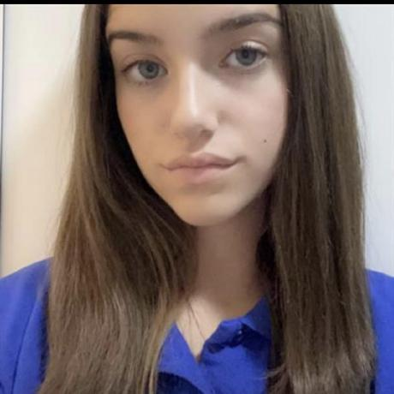
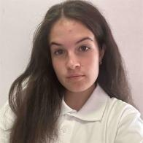
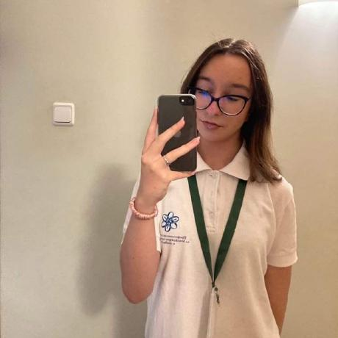
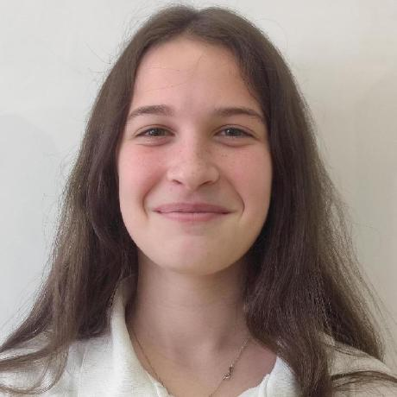
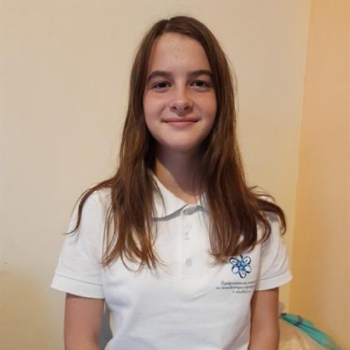
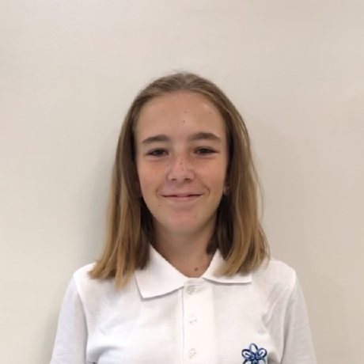
Our Team
Veselina Varadeva 9V SCRUM Trainer
Teodora Skulieva 9V Back-end developer
Gabriela Encheva 9V Back-end developer
Mariela Dimova 10G Back-end developer
Stela Georgieva 10B Q&A
Bilyana Badalova 10B Back-end developer

Slide 3
Stages of creation
1
2
3
Choose an idea
Work on the project
Finishing the project

Slide 4
The idea
The idea of the project is a console app with an educational purpose, focusing on teaching the C++ programming language.

Slide 5






Technologies

Slide 6
Let’s get to the project

