Slide 1

Project’s presentation

Slide 2
Table of contents
01
03
02
Our team
Stages of realization
Our goal
Used technologies
04

Slide 3
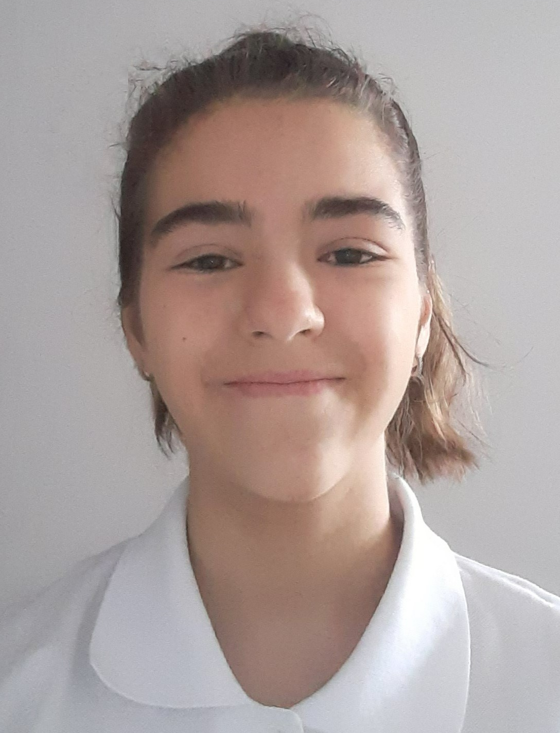
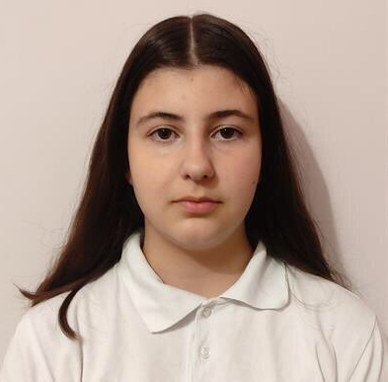
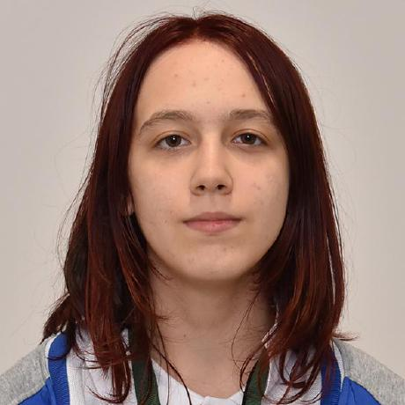



Our team
01
Nadezhda Ivanova 10th grade
Valeria Chavdarova
10th grade
Antonia Taneva
10th grade
Ivan-Michail Ivanov
9th grade
Scrum Trainer
Back-End developer
Back-End developer
Back-End developer
Nikolay Kulov
9th grade
Pavlin Peev
9th grade
Back-End developer
Back-End developer

Slide 4
Our goal
01
02
The main goal of the game is to make learning more interesting and easier for the player.

Slide 5
Stages of realization
01
03
Organization
Decide on the idea
Development
Presentation

Slide 6









Used technologies
01
04

Slide 7
Thank you for the attention
Let’s continue with the game

