Slide 1
TEAM 14

Slide 2
01
02
03
Our Team
Our Idea
Used Technologies

Slide 3
Our Team
01
And everything you need to know about us

Slide 4
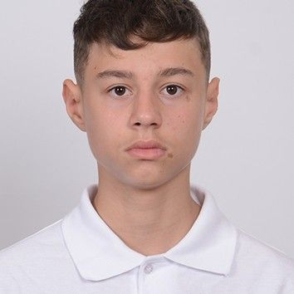
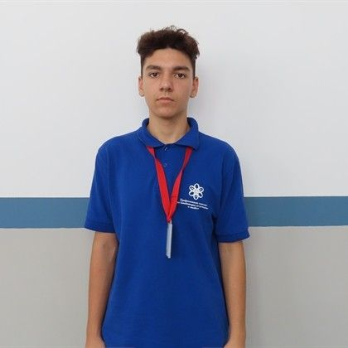
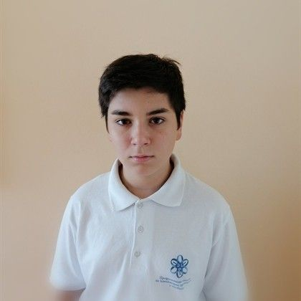
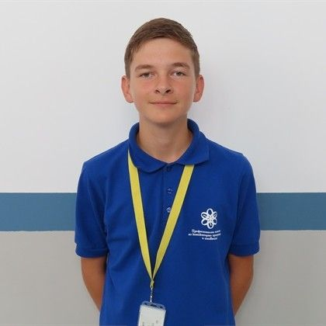
Kaloyan Pozharlev
Kaloyan Boychev
Scrum-Trainer
Back-End Developer
Martin Dimarov
Emanuil Tinchev
Front-End Developer
QA Documentation

Slide 5
Our Idea
02
And the stages in which we realized it

Slide 6
Our Idea
Our project presents a maze-based adventure game in which a young boy must navigate a dense forest to return to his village. Players explore branching pathsthat support progression and reveal parts of the story.

Slide 7
03
Used Technologies
And their purpose

Slide 8









Slide 9
04
Lets head to our project

