Slide 1


Bluelens

Slide 2
Table of contents
2
OUR GOAL
4
USED
TECHNOLOGIES
3
STAGES OF REALISATION
1
OUR TEAM

Slide 3
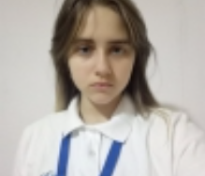
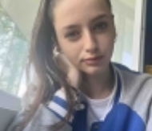
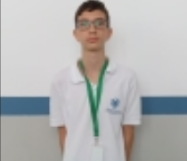
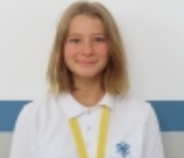
Our team
Амелия Олександривна Дорош
Белослава Златкова Илева
Виктор Борисов Николов
Варвара Николаевна Сафонова
QA
Backend Developer
Frontend Developer
SCRUM Trainer

Slide 4
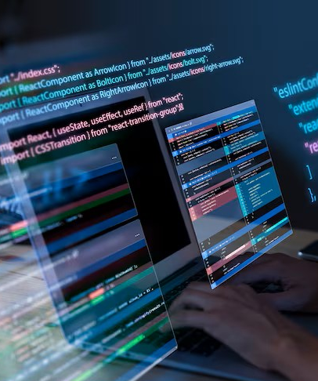
Our goal
Our project is a maze game that helps players improve their logical thinking. It encourages users to make smart decisions and find the best path to the goal.

Slide 5

Stages of realisation
DECIDE ON THE IDEA
DEVELOPMENT
PRESENTATION
ORGANISATION

Slide 6






Used technologies

Slide 7

Are you ready to start the program?

