Slide 1

Team PathX

Slide 2
Table of contents
1. Our Team
2. Stages of realization
3. Used tools

Slide 3

01
Our Team
Everything you need to know about us.

Slide 4
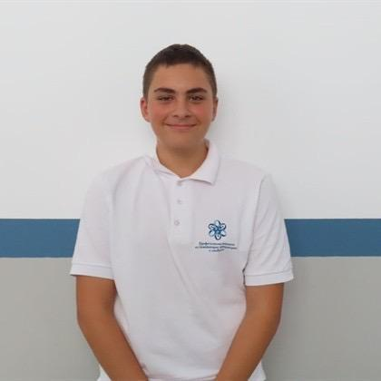
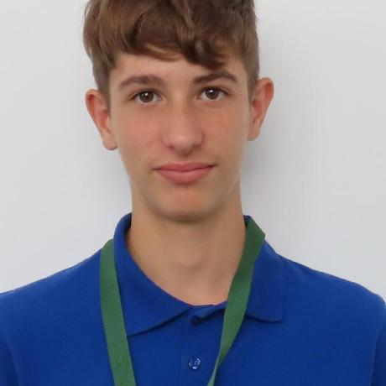
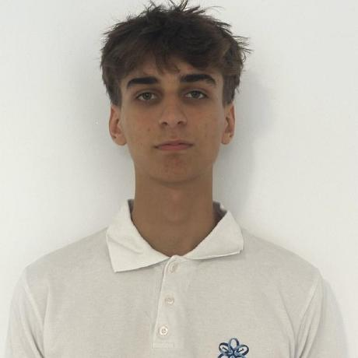
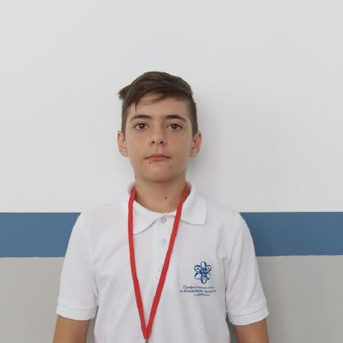
Team PathX
Pavel Parvanov – 10V
Konstantin Turmanov – 10A
Back-end Dev.
Scrum-trainer
Lyubomir Kumanov – 10G
Martin Yanev – 10B
QA
Front-end Dev.

Slide 5
02
Stages of realization
How we came up with the idea

Slide 6
Stages of realization
We decided to keep things simple. Want to pass the time? Give our game a try! You can customize the difficulty and level up as you play.

Slide 7
03
Used tools
The tools used in the project

Slide 8










The tools and technologies used

Slide 9
04
Lets go to our project
https://github.com/codingburgas/sprint-10th-grade-pathx

