Slide 1
Team CODE FORGE

Slide 2
Contents
About Us
Our Idea
Technologies
Demo

Slide 3
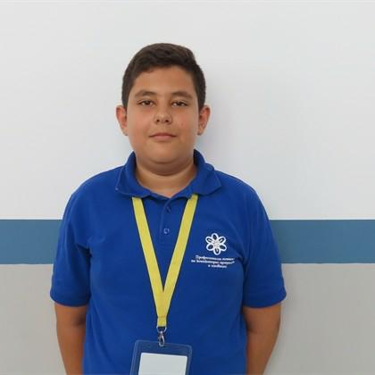
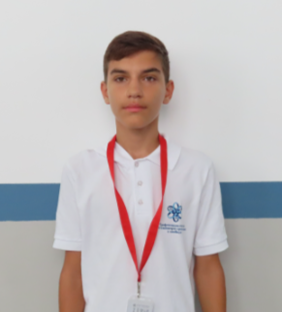
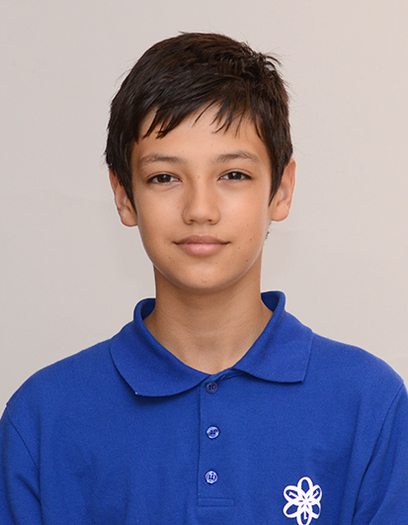
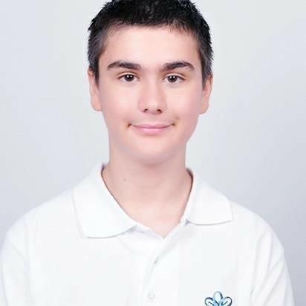
About Us
Cvetomir Luchev
Frontend
developer
Kristiyan Daradjanov
Scrum Trainer
Nikolai Dimitrov
Backend
developer
Kristiyan
Parashkevov
Designer

Slide 4
Contents
About Us
Our Idea
Technologies
Demo

Slide 5
Our idea
SNIMKA TUK
Code Forge is a team project designed to help students test and improve their knowledge through a single interactive electronic test. The test focuses on assessing students' understanding of various subjects in an engaging and educational way.

Slide 6
Contents
About Us
Our Idea
Technologies
Demo

Slide 7







Technologies

Slide 8
Contents
About Us
Our Idea
Technologies
Demo

Slide 9
Now let’s check out a quick demo

