Slide 1
class Presentation {
forbeginners.cpp
workshop.cpp
public:
string Team_Name = Concorde;
}
Programming Language: C++

Slide 2
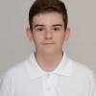



class Our_Members2 {
forbeginners.cpp
workshop.cpp
Designer: Mihail Karanikolov
Back-end developer: Kristian Andreev
Front-end developer: Stilian Palazov
Scrum Trainer: Bojidar Georgiev
}
Programming Language: C++

Slide 3






class Used_apps {
forbeginners.cpp
workshop.cpp
Discord / Teams: for communication
Visual Studio 2022: for writing code
PowerPoint / Word:
for presentation and documentation
GitHub: for submitting out work
}
Programming Language: C++

Slide 4
Cout << “What we want to avchieve: “;
forbeginners.cpp
workshop.cpp
Our application is designed to make online test about literature for 9th and 10th grade with accurate grade system and leaderboard to compete with others.
Programming Language: C++

Slide 5
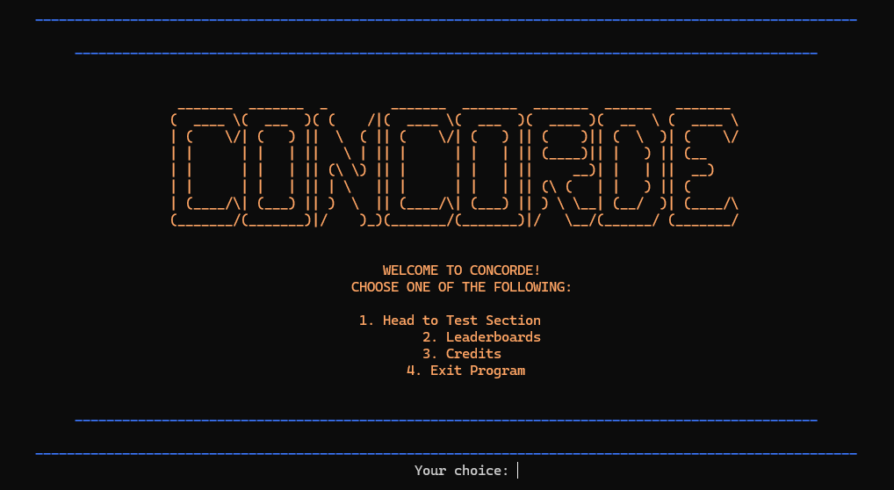
Review “Concept” {
forbeginners.html
workshop.css
}
Programming Language: C++

Slide 6
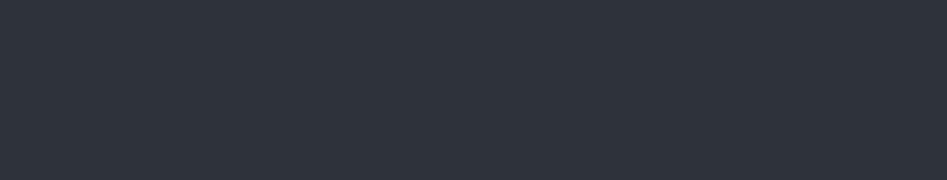
int main{
forbeginners.html
workshop.css
cout << “Now let’s run a”;
cout << “quick test…”;
}
< Please keep this slide for attribution >
Programming Language: C++

