Slide 1


Slide 2
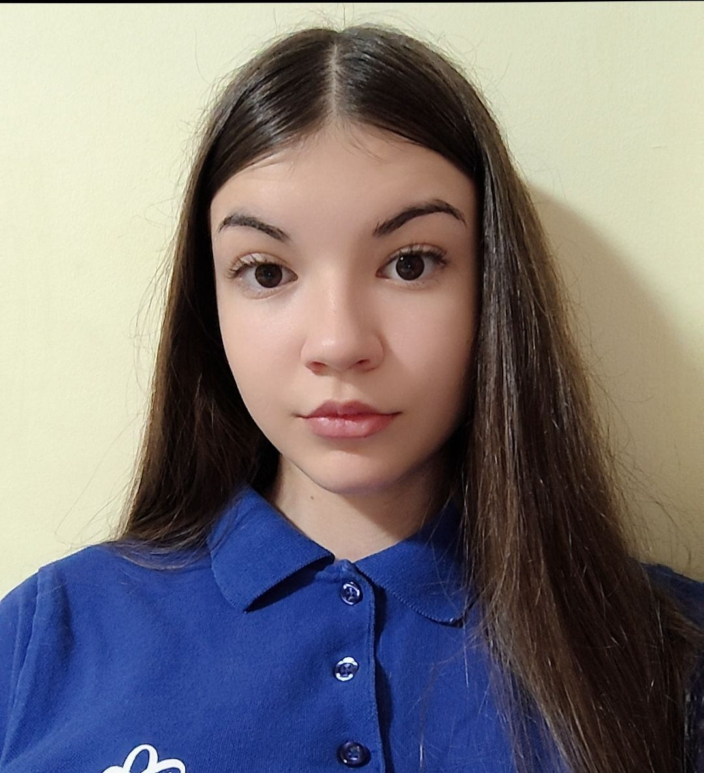
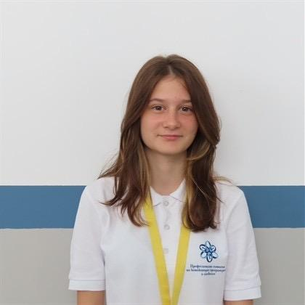
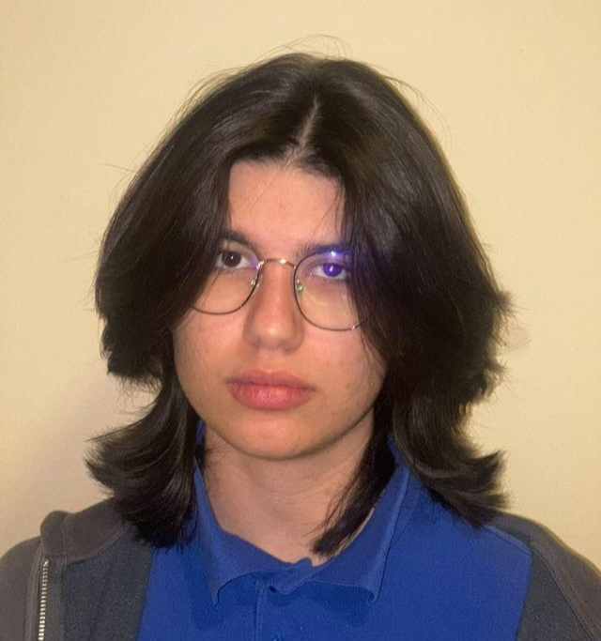
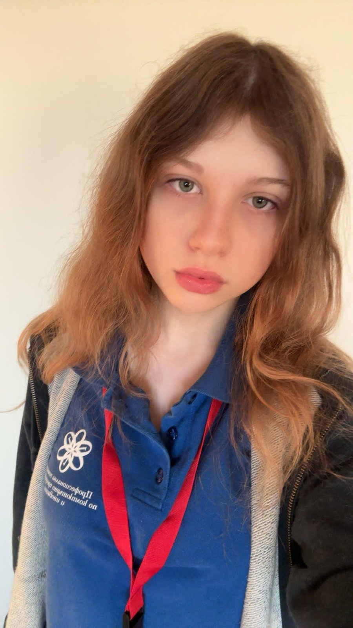
Our team​
Rosica Parapanova
Raq Kirilova
Scrum Trainer
Designer
Roberta Hristova
Leq Susova
Frontend Developer
Backend Developer

Slide 3
About our electronic test
The test is a functional and effective tool for testing knowledge in natural sciences.
It provides quick feedback, a clear final result and the ability to choose a category.
It is written in C++ and is designed to assess the user's knowledge in three main categories of natural sciences: Biology, Chemistry and Physics.

Slide 4







Stages
1st week
2st week
3st week
4st week
We were thinking about our logo and what project should we make
We were
organizing meetings
We finished the project and made a presentation
and documentation
We started working on the project

Slide 5
Used Technologies

Slide 6
Thank you for the attention!

