Slide 1




GIT GUD
Online school

Slide 2



TABLE OF CONTENTS
1.
2.
3.
Our team
Idea
Process & Technologies
www.gitgud.com

Slide 3

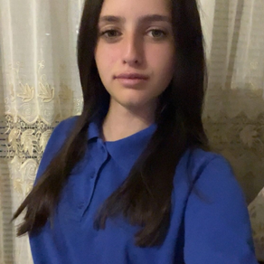
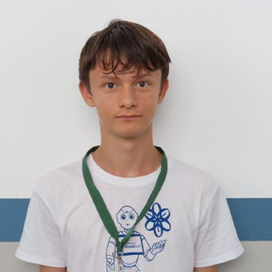
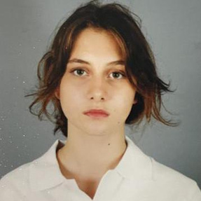
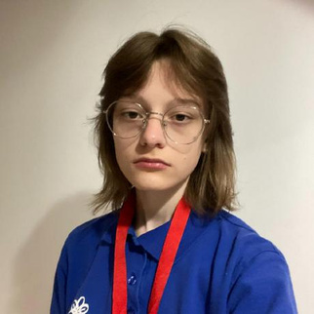
TEAM
Beloslava Ileva
Scrum trainer
Ivelin Metodiev
Front-End Developer
Ivayla Keserdzhieva
Back-End Developer
Ekaterina Zalinskaya
Designer
www.gitgud.com

Slide 4

Our mission is to create an interactive online school. Our platform is designed to make learning not only easier but also more enjoyable. Through tests, students can assess their knowledge, while additional exercises provide extra preparation for those who want to deepen their understanding. To enhance the learning experience, we also offer 3D models that help simplify complex concepts.
IDEA
www.gitgud.com

Slide 5









USED TECHNOLOGIES & PROCCES
Week 1 - 4
Week 1- 4
Week 1 - 4
Week 3
Week 1 - 3
Week 4
Week 1 - 4
Week 3
www.gitgud.com

Slide 6
LET’s continue to our project
www.gitgud.com

