Slide 1


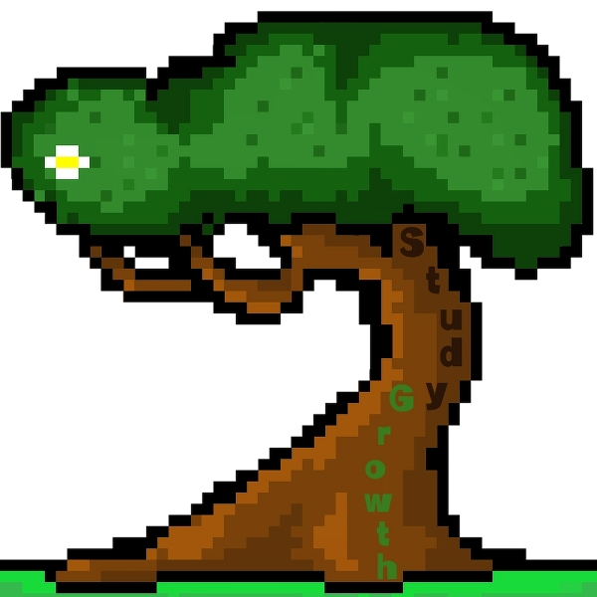
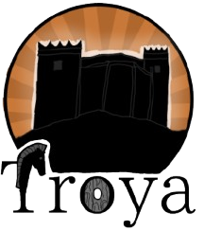

Slide 2

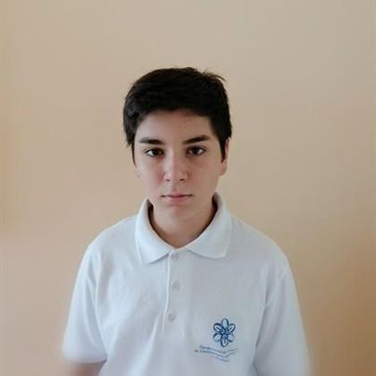
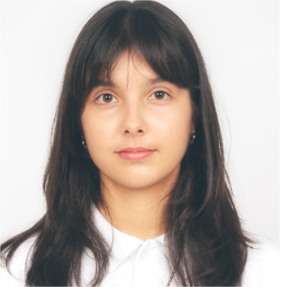
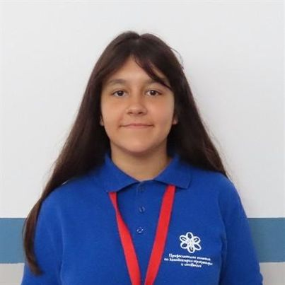
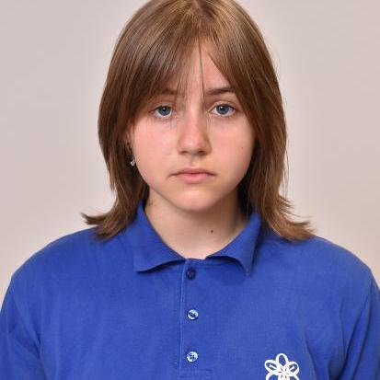






Slide 3
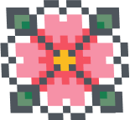
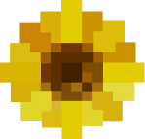

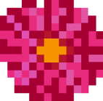





Slide 5



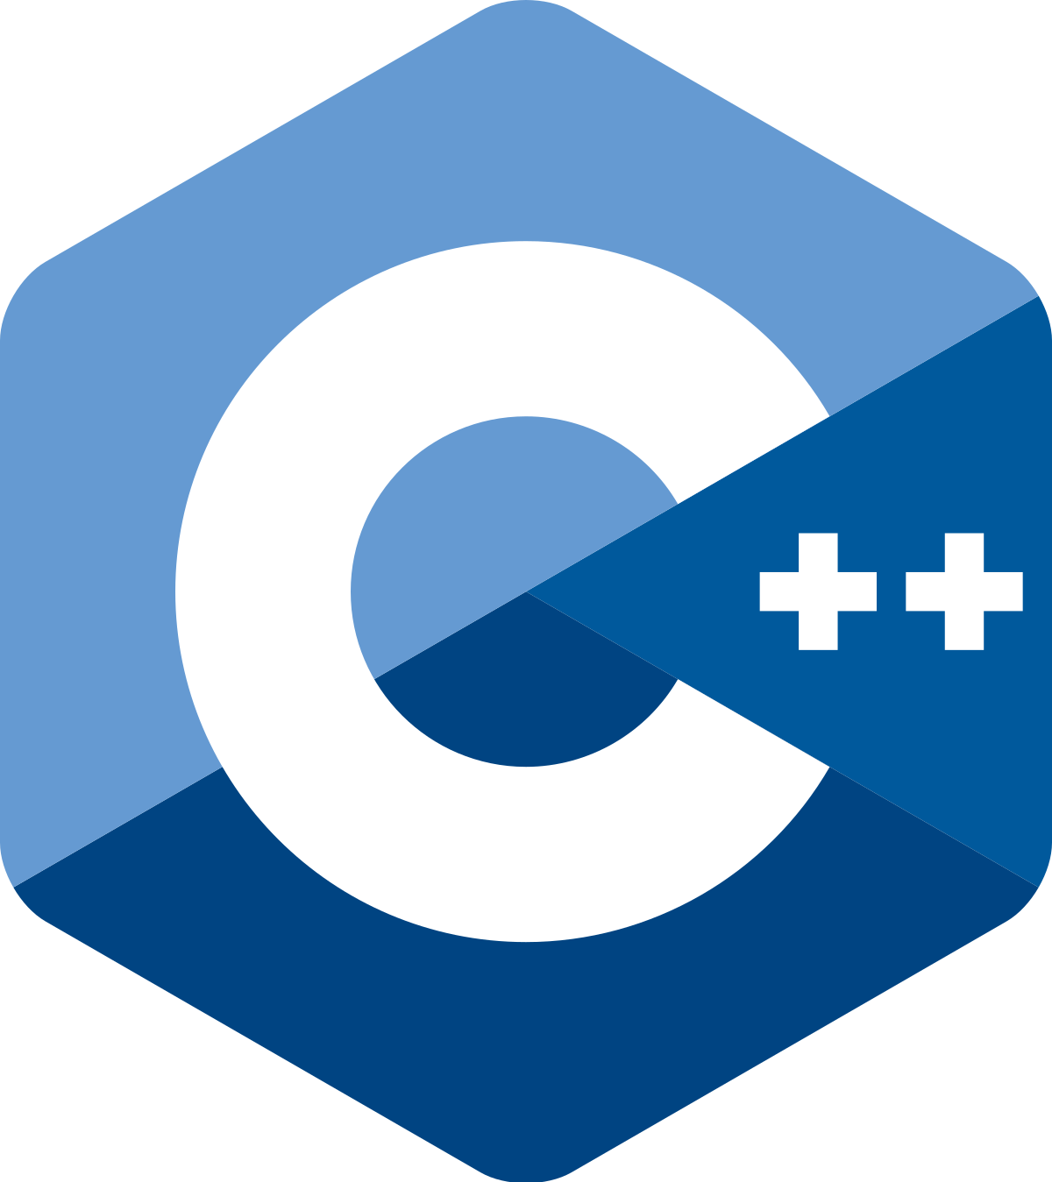

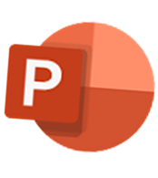


Medibang paint
GitHub
For the creation of the logo
For storage and collaboration
Raylib
UI of the app
C++
Game developement
Visual Studio 2022
PowerPoint
Build code
For presentation
Discord
For comunication
Word
For documentation
Not sure which major to choose? Try it first!
In Bulgaria, students pick a high school major too early, often without guidance. StudyGrowth helps you explore different university majors after 12th grade with real lessons and homework.
Choose a major
Learn & practice
Track your progress
No pressure—just the right choice for your future!
Download now!

Slide 6

Word
Discord
For documentation
For comunication
Visual Studio 2022
PowerPoint
Build code
For presentation
Medibang paint
C++
For the creation of the logo
Game developement
GitHub
Raylib
For storage and collaboration
UI of the app

Slide 7
Medibang paint
GitHub
For the creation of the logo
For storage and collaboration
Raylib
UI of the app
C++
Game developement
Visual Studio 2022
PowerPoint
Build code
For presentation
Discord
For comunication
Word
For documentation

