Slide 1
Team CODE FORGE

Slide 2
Contents
About Us
Our Idea
Technologies
Demo

Slide 3
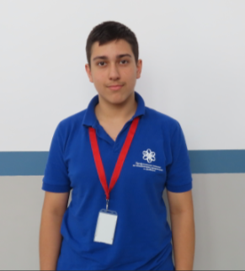
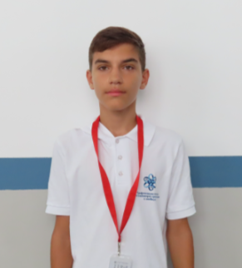
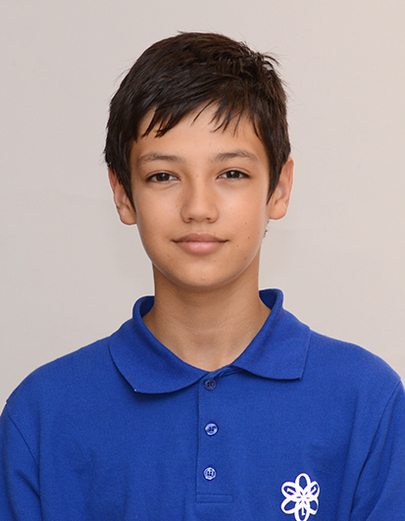
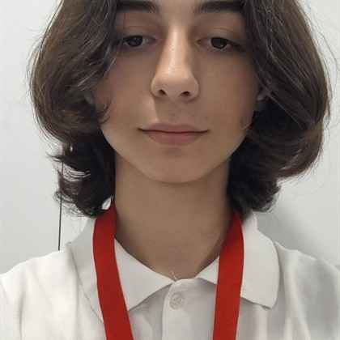
About Us
Kristiyan Daradjanov
Frontend
developer
Bojidar Georgiev
Scrum Trainer
Nikolai Dimitrov
Backend
developer
Hristiyan Grozdev
Designer

Slide 4
Contents
About Us
Our Idea
Technologies
Demo

Slide 5
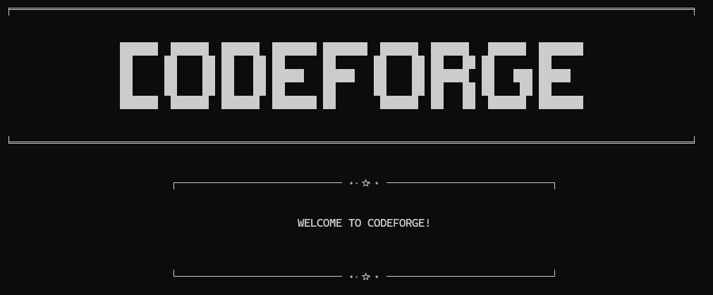
Our idea
Code Forge is a team project that revolves around helping students with improving their vocabulary and spelling with the help of games like "Hangman", "Wordle" and "Word Scramble“.

Slide 6
Contents
About Us
Our Idea
Technologies
Demo

Slide 7







Technologies

Slide 8
Contents
About Us
Our Idea
Technologies
Demo

Slide 9
Now let’s check out a quick demo

