Slide 1
CodeCraft

Slide 2
Table of Contents
01
02
03
04
Team members
Idea
Stages of Working
Technologies used

Slide 3
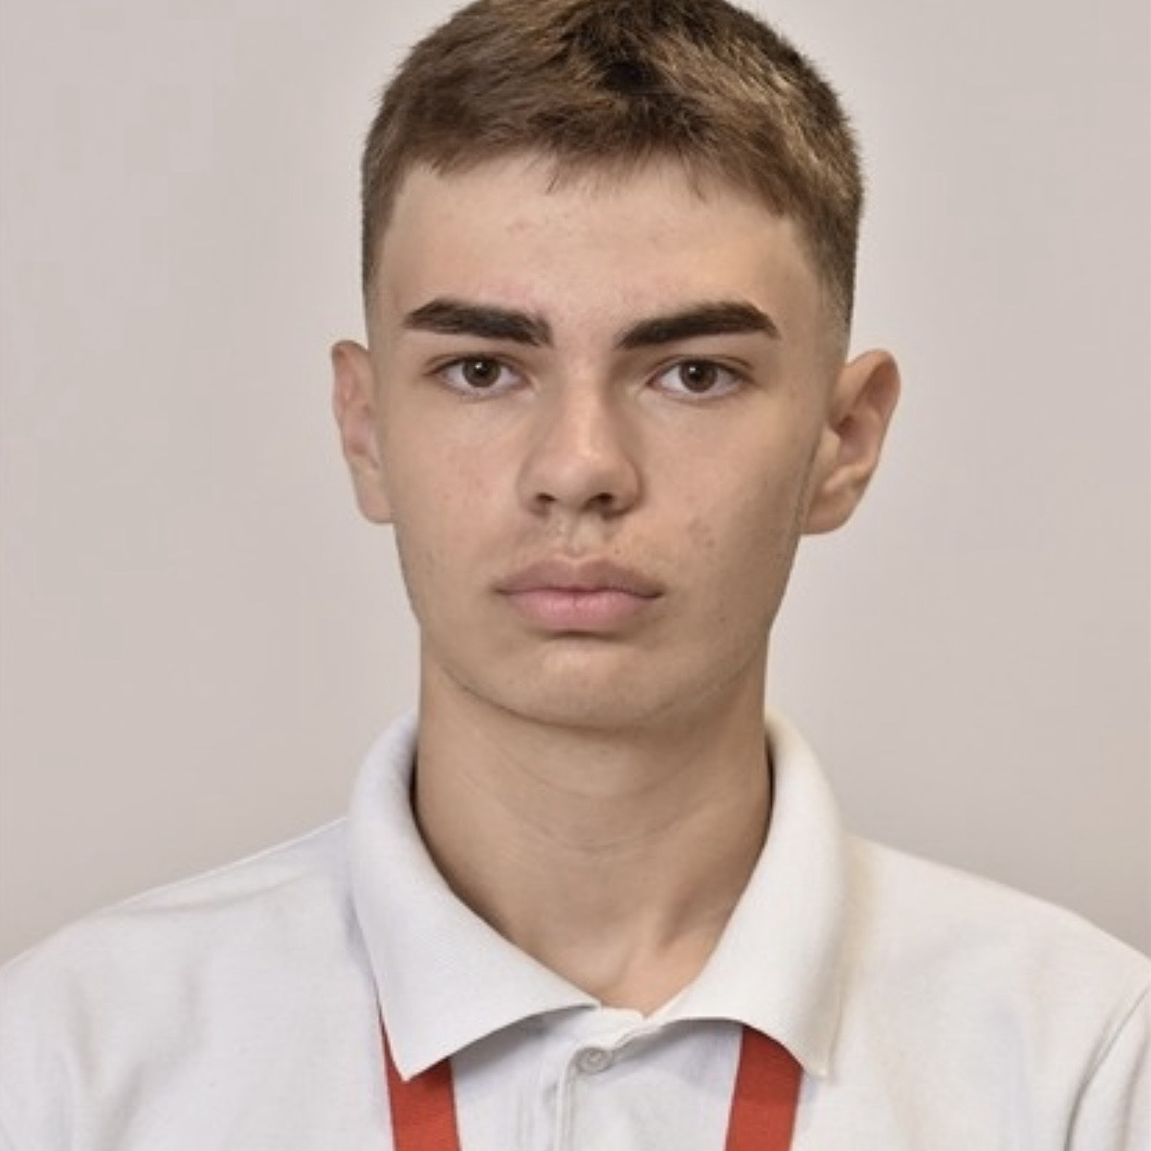
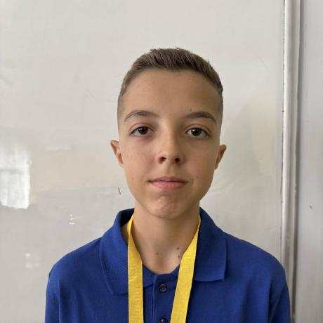

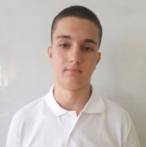
Team members
Ivaylo Georgiev
Toma Ivanov
Scrum Trainer
Back-End Developer
Dimitur Bornusuzov
Marin Marinov
Front-End Developer
Designer

Slide 4
Idea
Numeria is an adventure game where the player must restore the shattered Great Equation Stone by traveling through different mathematical realms. Each area—like the Village of Ones, Forest of Division, and Mountains of Geometry—contains story events and obstacles that unlock only when the player solves math puzzles.
The game’s purpose is to develop quick calculation skills and logical thinking through exploration instead of traditional exercises. In Numeria, the story progresses only when the player overcomes each mathematically-sealed challenge.

Slide 5
Stages of Working
01
02
03
First Week
Second Week
Third Week
Create the idea.
Create logo.
Make the Main Menu
Create the first 4 chapters.
Create the other 2 chapters.
Make the documentation, presentation and Read me

Slide 6






Technologies used

Slide 7
Let’s see the project!

