Slide 1
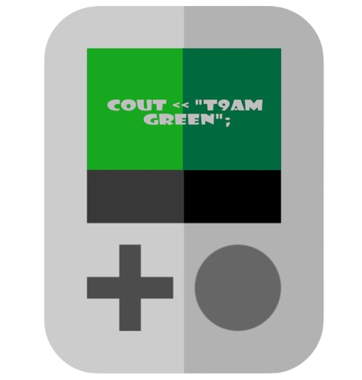
Cout << "t9am green";

Slide 2


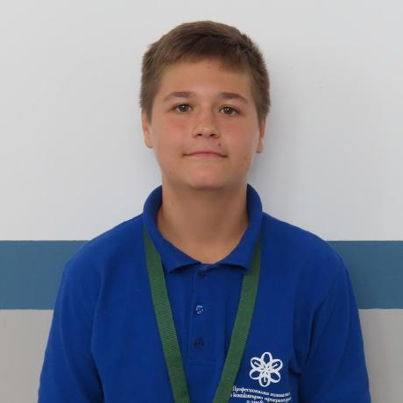
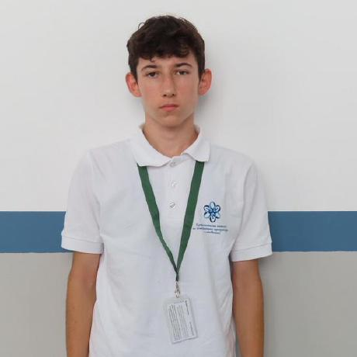
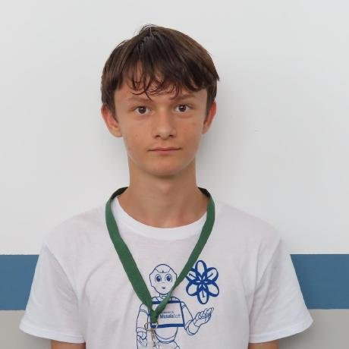
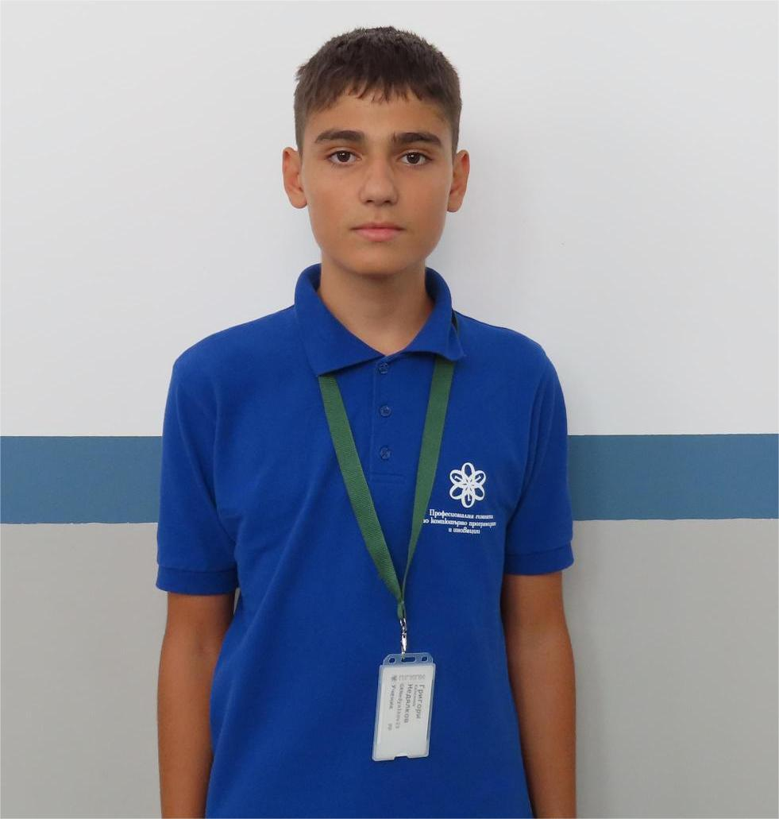
Our Team
Даниил
Молдованов
Scrum trainer
Джан
Мухтар
Designer
Ивелин
Методиев
Frontend Developer
Григори
Недялков
Backend Developer

Slide 3
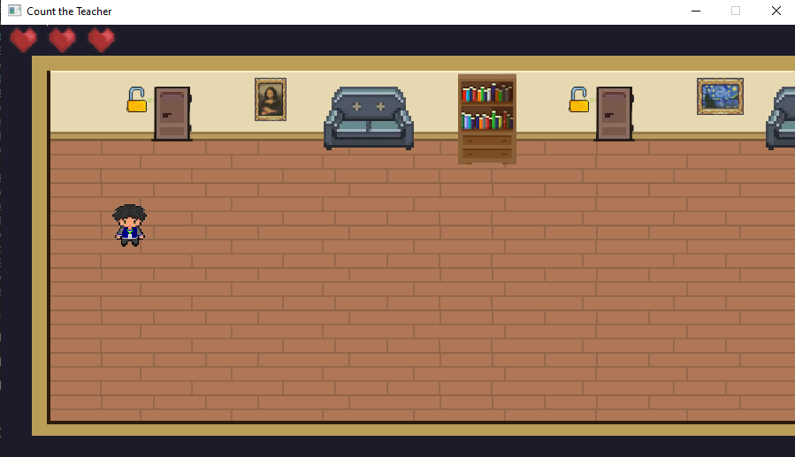
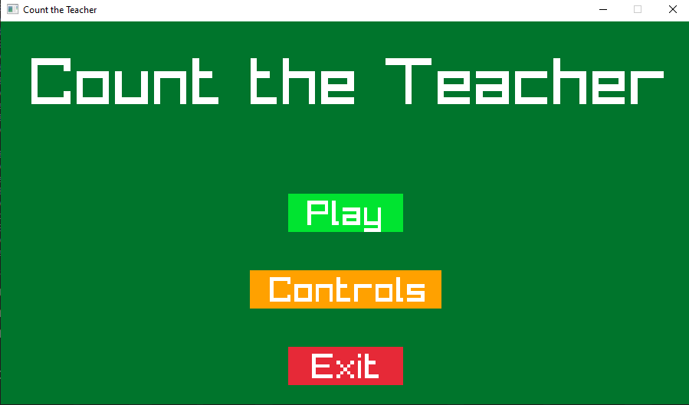
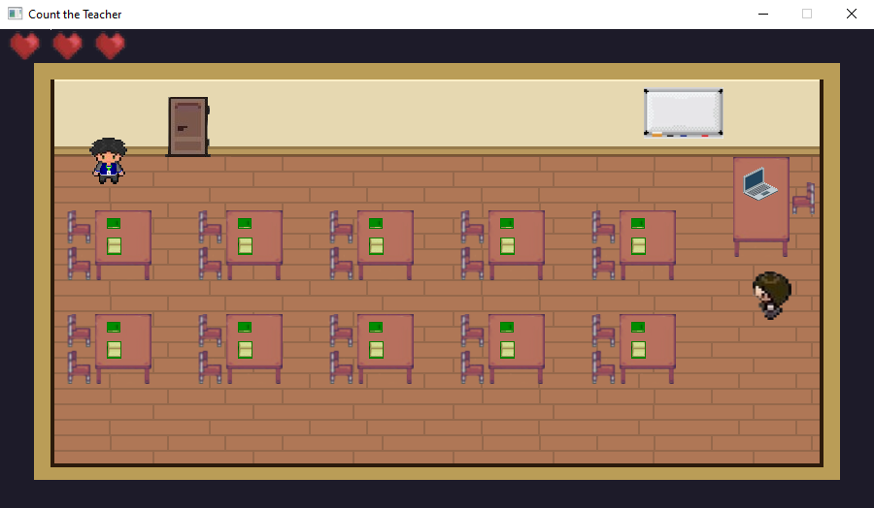
2. Idea

Slide 4

3. Stages
Choose an idea
Make a design
Make an application
Make documentation

Slide 5








3. Used Programs

Slide 6
Let’s go to our game

