Slide 1
Parolino
Password game

Slide 2
1/
Team

Slide 3
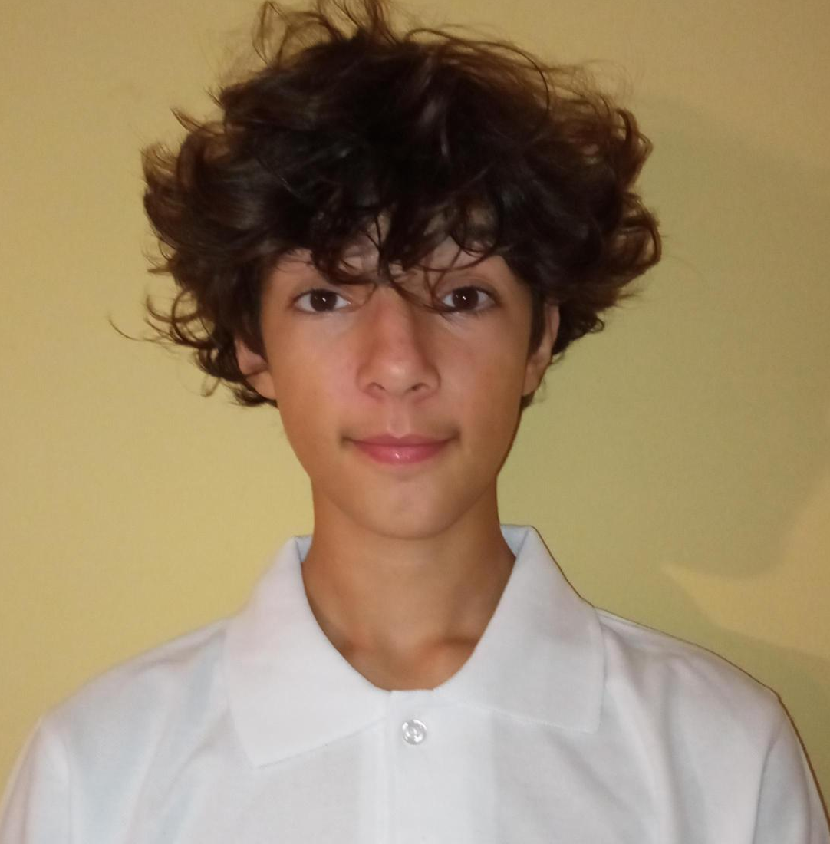



Dimitar Harisanov
-Scrum trainer
Mark Stoqnov
-Back-end Developer
Kristiqn Parashkevof
-Front-end Developer
Presiqn Tanchev
-Designer

Slide 4
Idea and teamwork

Slide 5
The origin of the idea
Overall the teamwork was very nice we understood each others idea and worked very nicely
Teamwork

Slide 6

Thanks!

