Slide 1
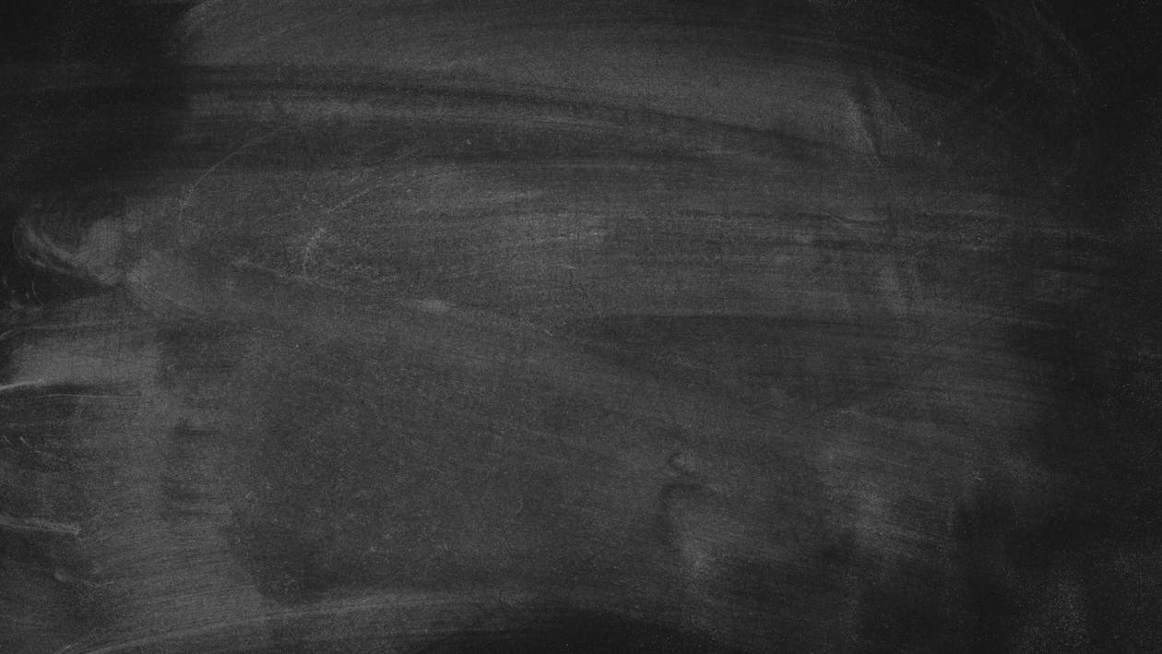
Team
Error 404

Slide 2




Our team
Galin Enev 9B
Iliyan Iliev 9V
Zlati Georgakiev 9G
Rosica Velkova 9A

Slide 3







Used technologies

Slide 4

Our goal
Create a working hangman game
Write organized code
Create a simple interface for users
Practicing teamwork

Slide 5
Let's get to the app!

